Slide 1

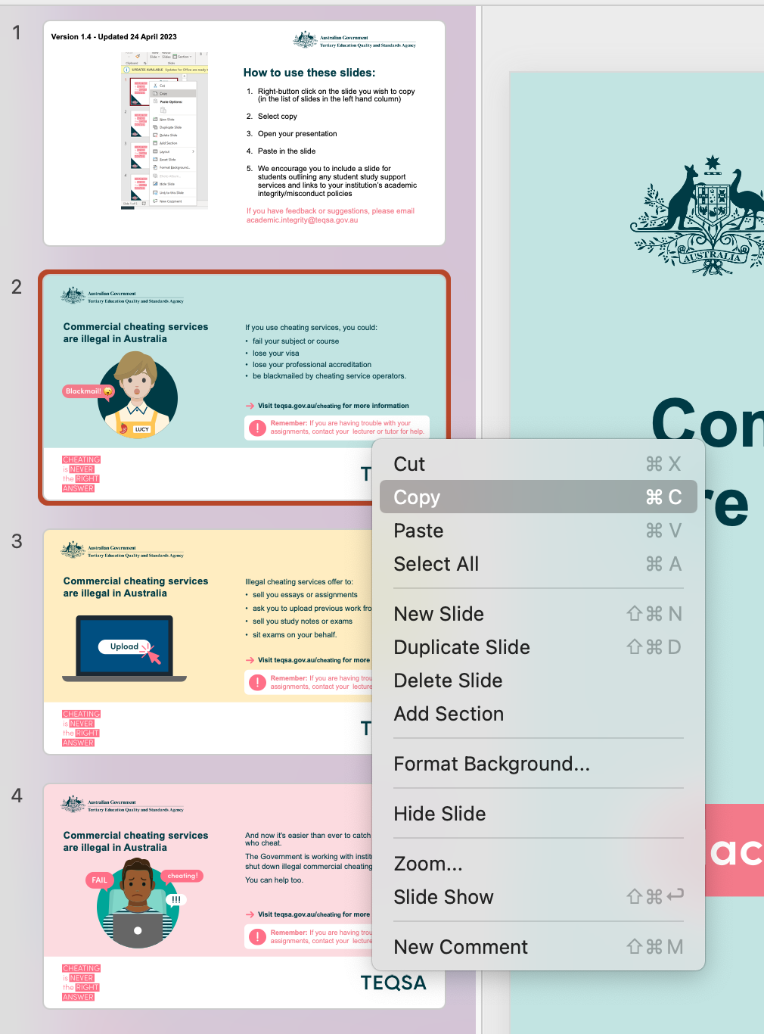
Version 3.0 - Updated 14 June 2023
How to use these slides:
Right-button click on the slide you wish to copy (in the list of slides in the left hand column)
Select copy
Open your presentation
Paste in the slide
We encourage you to include a slide for students outlining any student study support services and links to your institution’s academic integrity/misconduct policies
If you have feedback or suggestions, please email academic.integrity@teqsa.gov.au

Slide 2

Commercial cheating services are illegal in Australia
If you use cheating services, you could:
fail your subject or course
lose your visa
lose your professional accreditation
be blackmailed by cheating service operators.
Visit teqsa.gov.au/cheating for more information
Remember: If you are having trouble with your assignments, contact your lecturer or tutor for help.

Slide 3
Commercial cheating services are illegal in Australia
Illegal cheating services offer to:
sell you essays or assignments
ask you to upload previous work from your course
sell you study notes or exams
sit exams on your behalf.
Visit teqsa.gov.au/cheating for more information
Remember: If you are having trouble with your assignments, contact your lecturer or tutor for help.

Slide 4

Commercial cheating services are illegal in Australia
And now it's easier than ever to catch students who cheat.
The Government is working with institutions to shut down illegal commercial cheating services.
You can help too.
Visit teqsa.gov.au/cheating for more information
Remember: If you are having trouble with your assignments, contact your lecturer or tutor for help.

Slide 5

Commercial cheating services are illegal in Australia
It is illegal to sell or promote commercial academic cheating services
Criminal penalties include up to 2 years in prison and fines of up to $110,000
Students who use these services face disciplinary action in accordance with this institution’s policies.
Visit teqsa.gov.au/cheating for more information
Remember: If you are having trouble with your assignments, contact your lecturer or tutor for help.

Slide 6
What is academic integrity?
If you’re new to study at an Australian higher education institution, please note that academic integrity standards might be different from where you’ve studied before.
Make sure you understand your institution’s academic integrity policies and practices and follow them during your course.
Doing this will help you to uphold your own academic integrity and that of your institution.
Learn more at teqsa.gov.au/cheating
Remember: If you are having trouble with your assignments, contact your lecturer or tutor for help.

Slide 7
Report cheating services
Commercial academic cheating services are
illegal in Australia.
If you find ads for illegal cheating services on:
email
social media
campus posters or business cards
Report them at teqsa.gov.au/cheating
Remember: If you are having trouble with your assignments, contact your lecturer or tutor for help.

Slide 8
Do your own work
Providing academic cheating services to students at Australian institutions is against the law.
Do not write essays, complete assignments or
sit exams for other students.
You risk criminal prosecution including
2 years in prison and up to $110,000 in fines.
Remember: If you are having trouble with your assignments, contact your lecturer or tutor for help.

Slide 9



Got questions about using AI?
Technology is changing fast
So are the rules about using artificial intelligence
If you’re unsure what the rules are in this class, ask your lecturer or tutor.
?
Learn more at teqsa.gov.au/AI
Remember: If you are having trouble with your assignments, contact your lecturer or tutor for help.

Slide 10

Be smart when using AI
Technology is changing fast
So are the rules about using artificial intelligence
Make sure you understand this institution’s rules about AI and assessments
If you’re unsure, talk to your lecturer or tutor.
Learn more at teqsa.gov.au/AI
Remember: If you are having trouble with your assignments, contact your lecturer or tutor for help.

