Slide 1
SELF-ACCREDITING
TEQSA WEBINAR
17TH FEBRUARY 2021
Avondale University College, Self-Accrediting Status, A Case Study
Prof Jane Fernandez
Historical Detail: SAA Project [ 2012-2014] [SAA achieved in December 2014] Avondale thanks its governors, executives, leaders, staff, students, its several mentors and external experts who helped shape its success.

Slide 2
Self-Accrediting Status
Avondale: A Case History [Media Release 15th December 2014]
“Full self-accrediting authority means that a provider can self-accredit all of its higher education courses of study, including coursework and research higher degrees, having been judged as being capable of:
◆ interpreting the requirements of the Threshold Standards and;
◆ ensuring these will be appropriately applied and met throughout the development and life of all of its courses of study”.
“”Acting Chief Commissioner of TEQSA, Professor Nick Saunders said that this milestone was a good example of regulator and sector working together to ensure quality. “Self- accrediting authority is not granted lightly. Avondale College went through a rigorous assessment process conducted over several months. TEQSA also had the benefit of having accredited multiple Avondale College courses over the past few years, giving it significant insight to its internal processes of quality assurance and academic governance. TEQSA looked for evidence of proven experience, a history of low risk and most importantly, strong academic governance and the ability to self-assure critical higher education processes,” Professor Saunders said”.
https://www.avondale.edu.au/Departments/Learning-and-Teaching/TEQSA-Media-Release.pdf

Slide 3

INSTITUTIONAL DNA – FRAMEWORK AND METHODOLOGY SAA
CHOREOGRAPHY LADDER
RUNG 1 – NUANCING THE COURAGE
RUNG 2 – STEERING THE SHIP [EGAL Executives, Governors, Academic Leaders]
RUNG 3 - FLIPPING THE METHOD
RUNG 4 – KNOWING MY INSTITUTION
RUNG 5 – ALIGNING REF POINTS
RUNG 6 – APPLYING CHECKS & BENCHMARKS
RUNG 7- BUILDING & VALIDATING Application
No outstanding issues or conditions
Strong, defensible, sustainable, evidence-based history of compliance and regulation
At least 5 years of Successful course delivery
At least one cycle of implementation HESF
Depth and Breadth of AL and Highly Effective Governance Processes
Sustained Scholarship
3 cohorts of graduates
Professional Accreditation

Slide 4
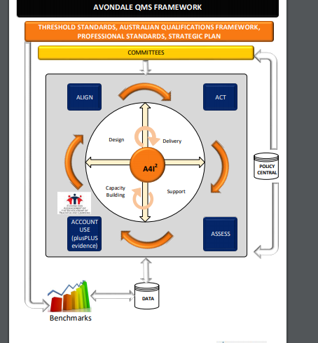
AVONDALE’S QUALITY MANAGEMENT SYSTEM [QMS]
REFERENCE POINTS [SP and Standards]
GOVERNANCE – Efficient Committee Structure
STEP-UP METHOD – A4I² [Align, Act, Assess, Account] for Impact & Improvement
4 DOMAINS – Design, Delivery, Support, Capacity-Building
Policy Repository
Evidence-Based [Data Sets]
Benchmarks

Slide 5

STEPPING-UP & STAYING UP
Own TEQSA’s role in-house
Embed respect for regulation
Make visible the QMS
Build responsive culture declaring and mitigating risks and stepping ahead of issues
Answer the question – have we closed the loop in risk mitigation? How do we know? Keep accurate records and assure reporting protocols
Own and Improve the Machinery of Course Review
Embed the Plus Plus Principle so that Internal Monitoring is complemented by External Auditing
Thank You

