Slide 1
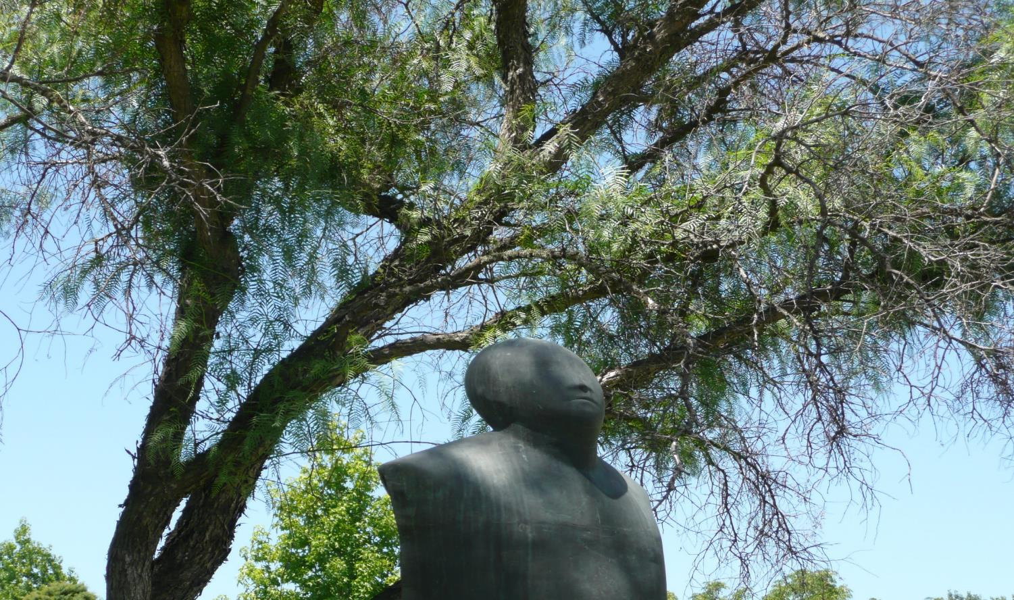
On Trust:
Quality Assurance
in an International Perspective
TEQSA, 28 November 2019

Slide 2
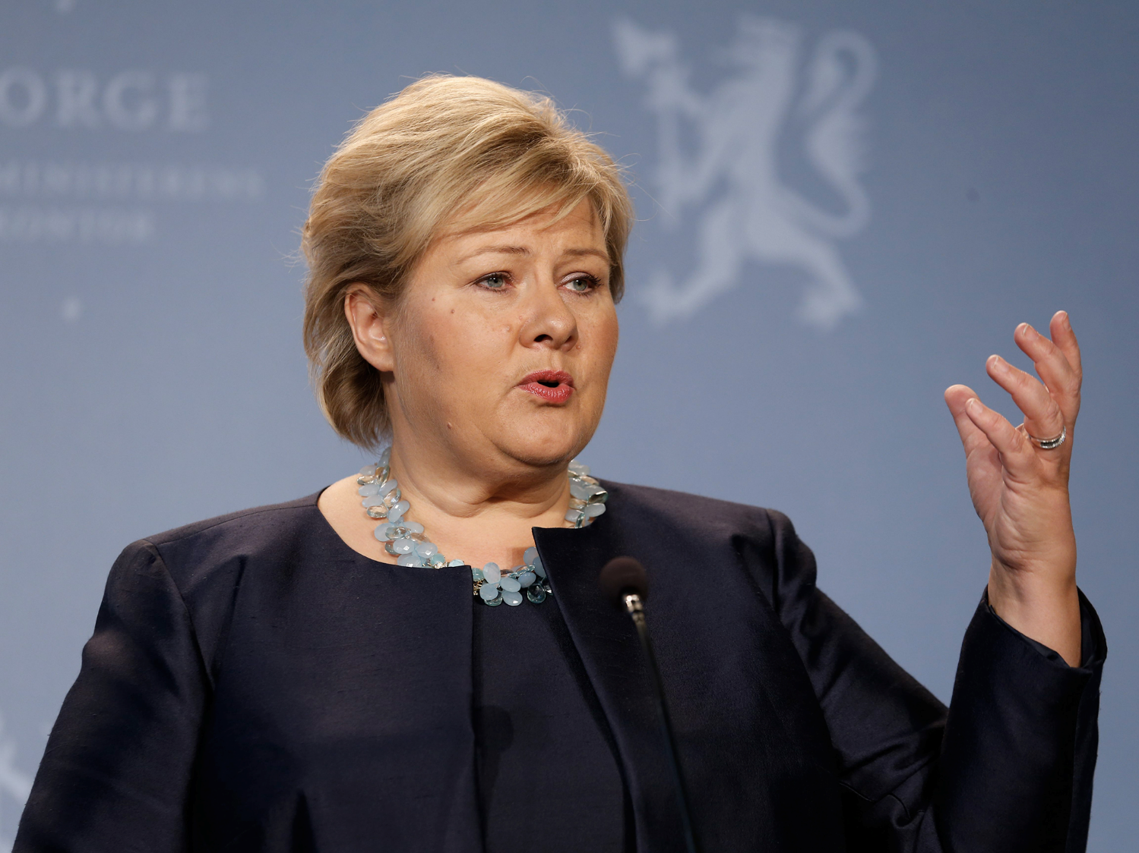

Slide 3


Slide 4
Tertiary education at the heart of economic growth
Nordic countries
Lisbon agenda of the EU
Asian tigers / dragons

Slide 5
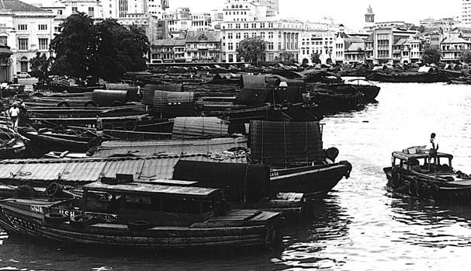

Slide 6

Singapore in 2016

Slide 7
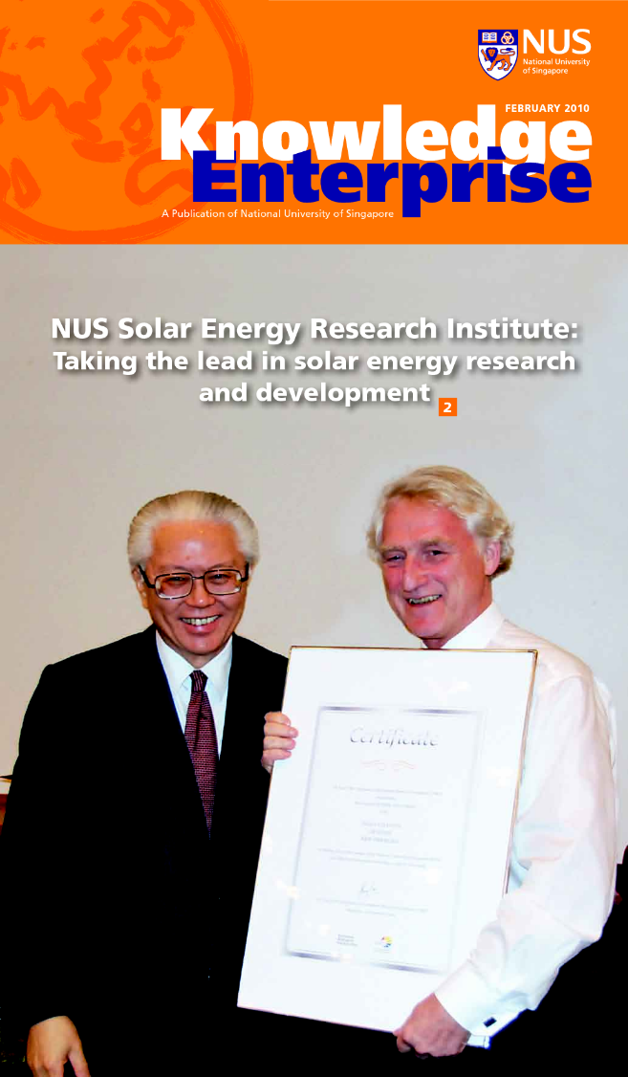

Creation of the Solar Energy
Research Institute

Slide 8
Contribution of NUS
Institute of Solar Energy Institute
  3.5 billion dollar investment

Slide 9
Tertiary education at the heart of economic growth
Nordic countries
Lisbon agenda of the EU
Asian tigers / dragons
Australia?

Slide 10

Outline
An Outsider’s View of Australia’s Performance
A Changing and Challenging World
The Erosion of Trust

Slide 11
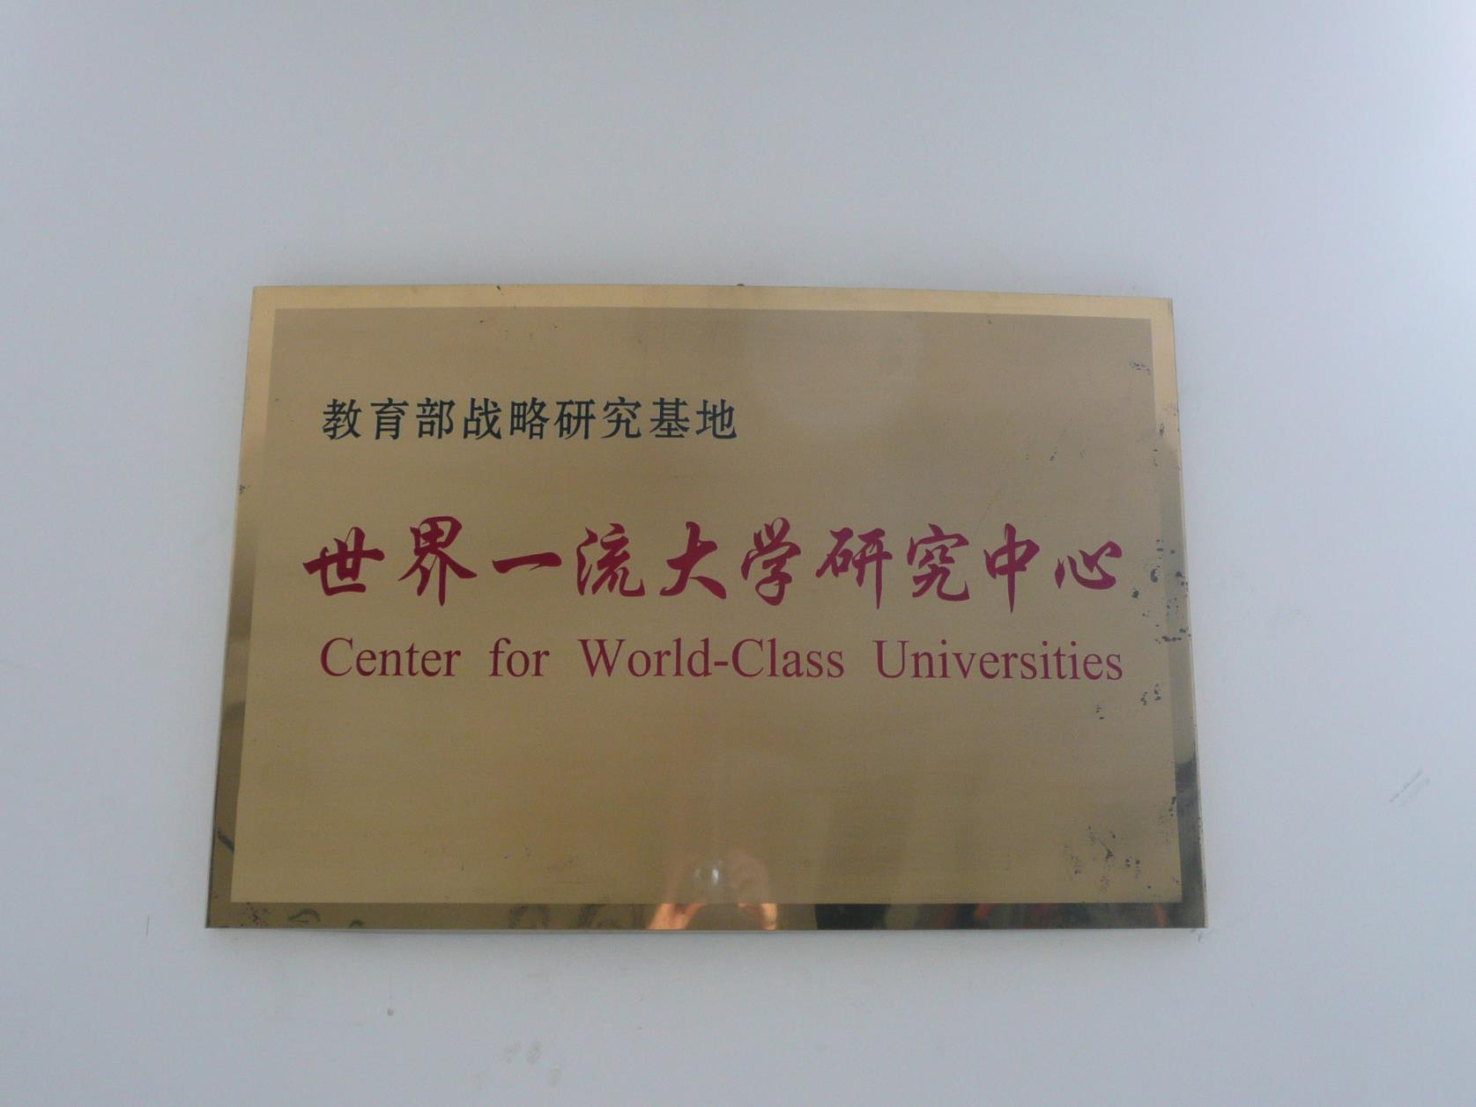

Slide 12
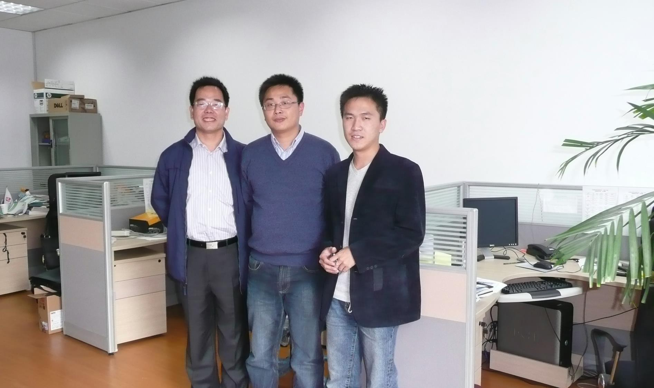
Heroes or Villains?

Slide 13
# top 100 /Log(pop) in 2004

Slide 14
# top 100 /Log(pop) in 2019

Slide 15
Main Changes in Top 100
17 countries in 2004, 18 in 2019
Austria and Italy out
Belgium, China and Singapore in

Slide 16
Who is rising in the rankings?
Country | 2004 | 2019 | Change
Australia | 2 | 7 | + 5
China | 0 | 4 | + 4
Belgium | 0 | 2 | + 2
Netherlands | 2 | 4 | +2
Singapore | 0 | 2 | +2
Switzerland | 2 | 4 | + 2
Denmark | 1 | 2 | +1

Slide 17
Equity Benchmarking

Slide 18
The Equity Champions
Australia, Cuba, England, Ireland, New Zealand and Scotland

Slide 19
Australia
Wide array of policies and instruments with both universal and targeted elements.
Comprehensive information system with detailed data disaggregated by equity groups, allowing proper targeting, adequate monitoring and accountability, and performance-based funding.
HECS-HELP = universal funding system, financially sustainable and socially equitable. Dedicated equity funding for low socio-economic status and Indigenous students.
HEPPP = catalyst by increasing the focus on student equity, promoting understanding of barriers to participation, and creating an expert workforce on equity issues.
Equity is one of the QA criteria (2015 Threshold Standards)

Slide 20
However…
Public funding less forthcoming
Over-reliance on international students
Differences in attainment across the six states
Lack of mission and program differentiation within the university sector
Insufficient connection between universities and non-university tertiary education providers
Complaints of over-accountability

Slide 21
Outline
An Outsider’s View of Australia’s Performance
A Changing and Challenging World

Slide 23
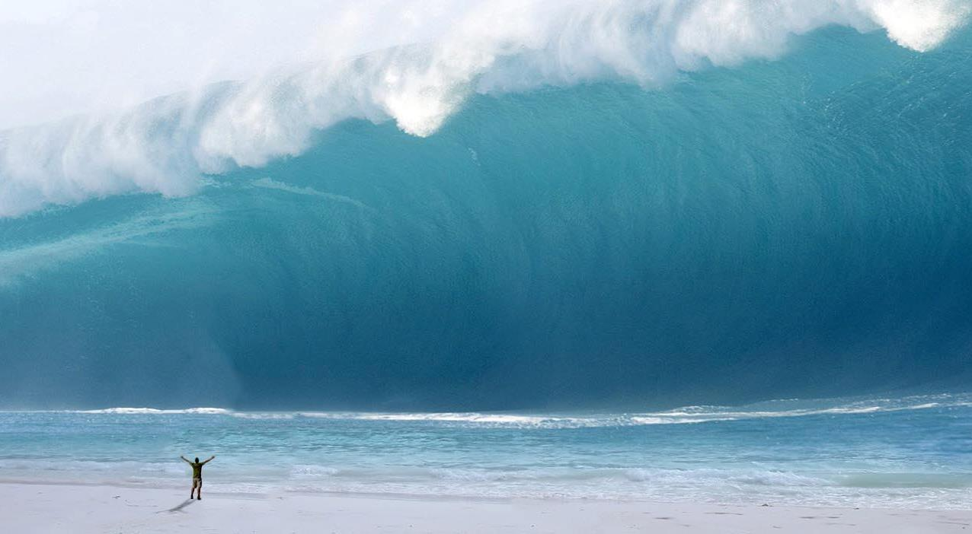

Slide 24
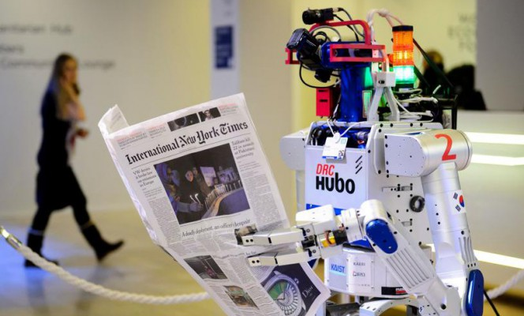

Slide 25
The future of jobs
(labor markets in the digital era)
Jobs that disappear (700 professions)
New jobs

Slide 26
Jobs that did not exist 10 years ago
App developer
Social media manager / YouTube content creator
Digital risk manager
Smart city / smart building architect
Driver-less car engineer
Cloud computing specialist
Big data analyst
Sustainability manager
Drone operator

Slide 27
The future of jobs
(labor markets in the digital era)
Jobs that disappear (700 professions)
New jobs
Jobs that are undergoing transformation (47%)

Slide 28
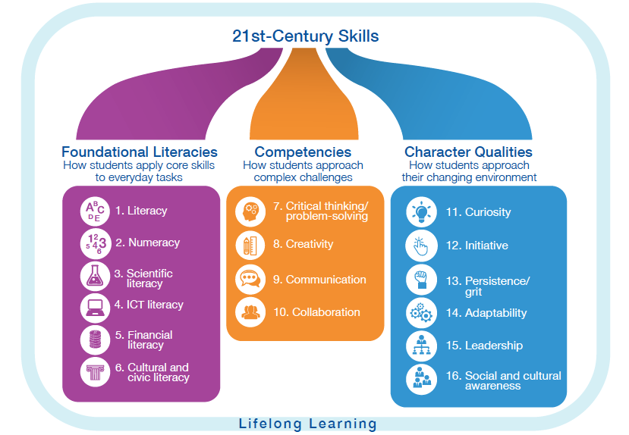

Slide 29
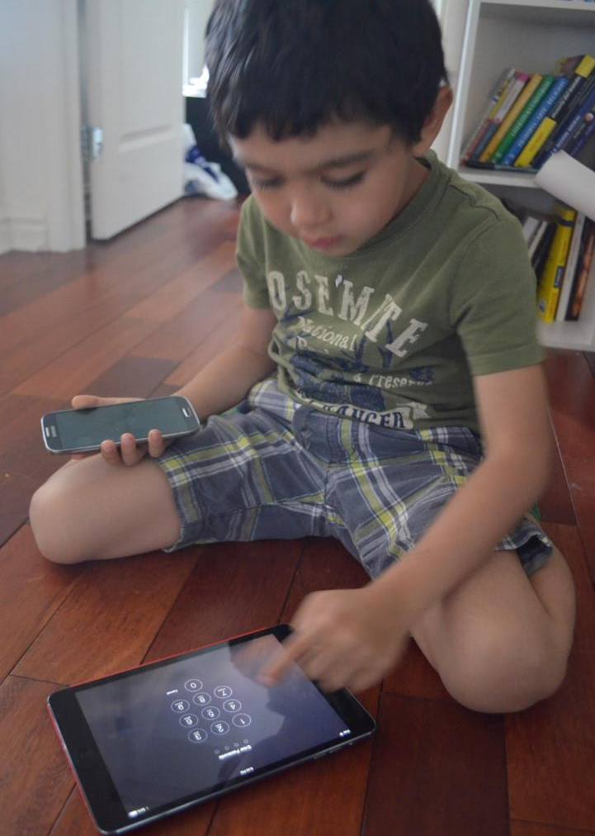

Profile of the learners

Slide 30






E-Generation

Slide 31
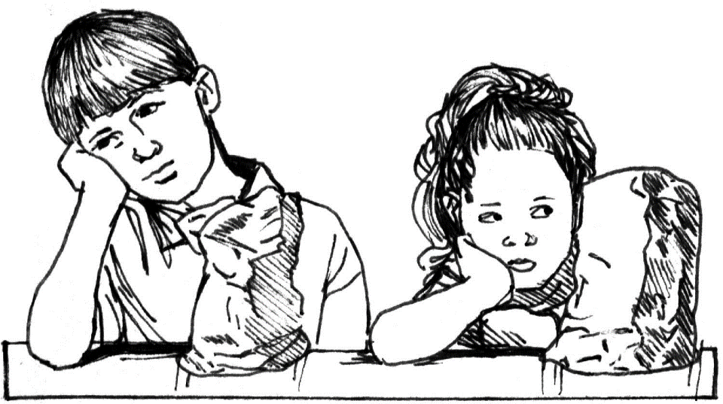
Learning is not a spectator sport

Slide 32
Student-Centered
Learning
Sparking Curiosity
  Igniting Passion
    Unleashing Genius

Slide 33
Educational Innovations
Curriculum (multi-disciplinary, experiential / problem-based /design-based, competency-based)
Student-centered teaching through active & interactive pedagogical approaches
Aligned assessment
Appropriate use of new technologies (AI, big data, VR, blockchain)

Slide 34
Golden Triangle
Assessment
Appropriate Use of Technology
Curriculum
Pedagogy

Slide 35
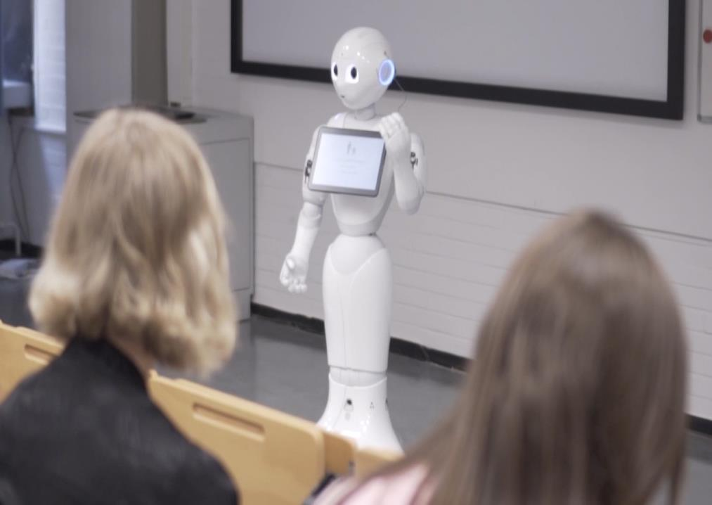

Slide 36
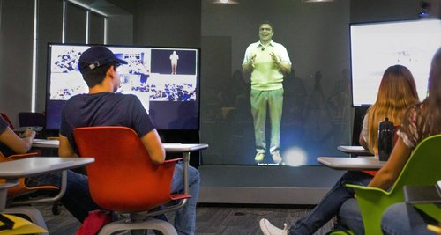

Slide 37
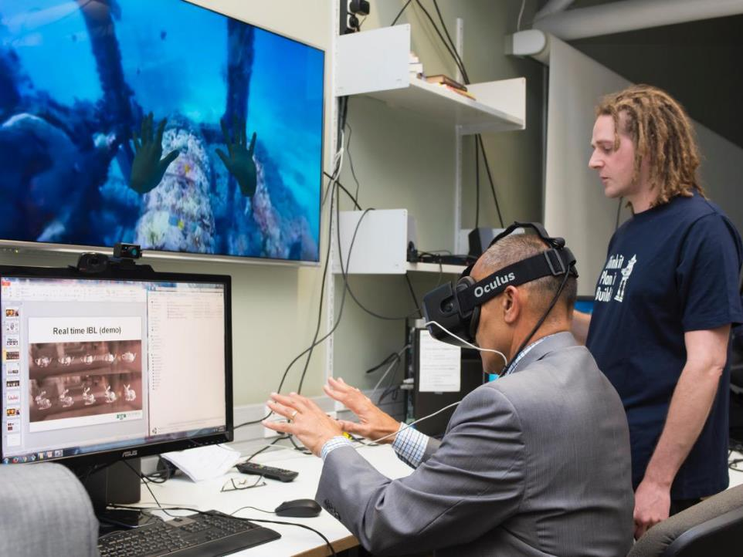

Slide 38
Today
Postgraduate studies
First degree

Slide 39
University of the future?
Undergraduate Studies
Multiple
On-campus
Citizenship & Life Skills
Graduate Studies
Itinerant
On-line
Hybrid
Career Change
Studies
Continuing Professional Development

Slide 40


Slide 41
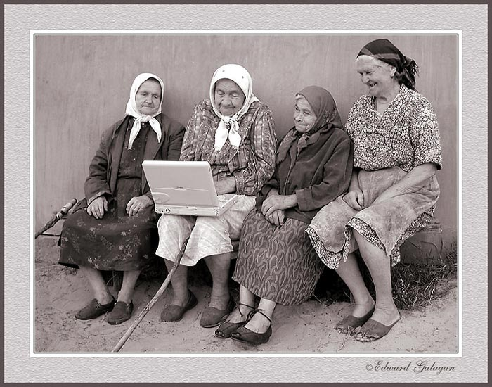

Slide 42
Shape of degrees
Traditional degrees (Bs, Ms, PhD)
Courses from several institutions / joint degrees
Micro-credentials and nano-courses (certificates, badges, etc.)
Mini-masters
Separation of learning / credentials

Slide 43


Slide 44


Slide 45
Beta mode
Continuous change and adaptation
Open mind to accept innovation
Humility: learning as you go

Slide 46
Outline
An Outsider’s View of Australia’s Performance
A Changing and Challenging World
The Erosion of Trust

Slide 47
Two Major Challenges
A World Fraught with Fraud
A Post-Truth World

Slide 48
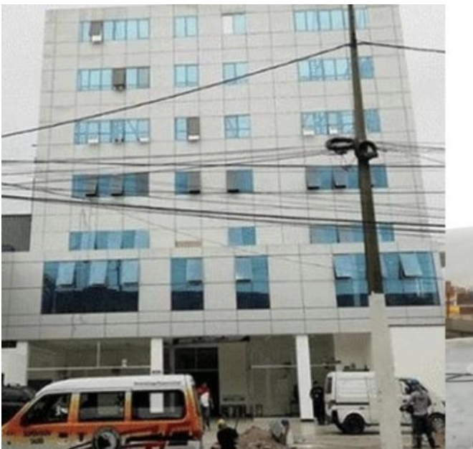

Slide 49
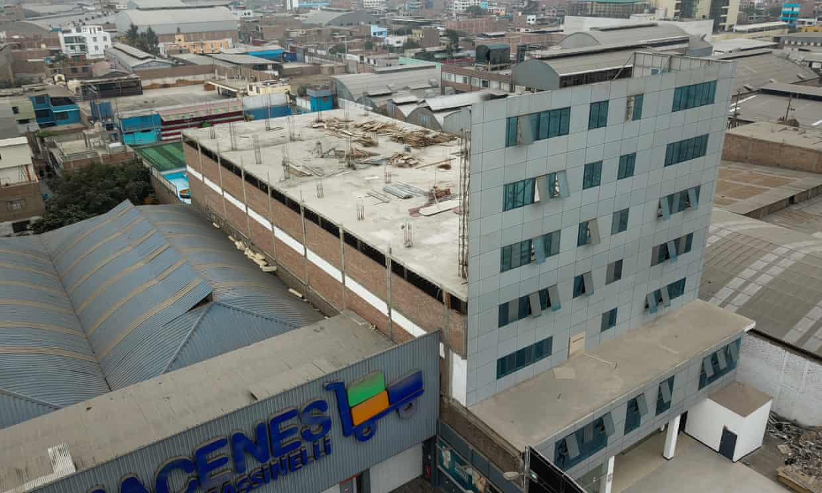

Slide 50


Slide 51
Fraud & Corruption
Admission
Plagiarism
Fraud at exams
Contract cheating
Sexual harassment
Degree mills (esp. online)
Accreditation mills
Fake academic journals and conferences

Slide 52
Counter-measures
Shame
Prison (SA)
Technology

Slide 53


Slide 54
Counter-measures
Shame
Punishment (SA)
Technology
Independent measures

Slide 55
Aspiring Minds
Indian company administering the AMCAT competency test (job employability)
1,100 Universities use AMCAT
5 million people tested in 2018
Now active in Bangladesh, China, Malaysia, the Philippines, the Middle East, and the USA

Slide 56


Slide 57
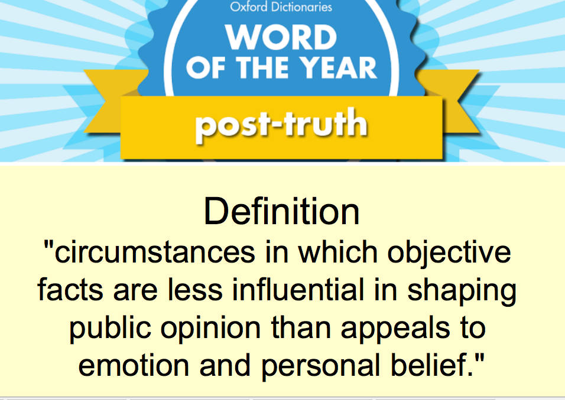

Slide 58
Brexit(s): the end of rationality
Leaving the EU will save the UK millions of pounds
We are done listening to the experts
President Bush: “I don’t care what the facts say”
Trump administration (Mr. Spicer):
  “We would like to present alternative facts”
  “Sometimes we can disagree with the facts.”
Fake news, untruths and post-truth

Slide 59
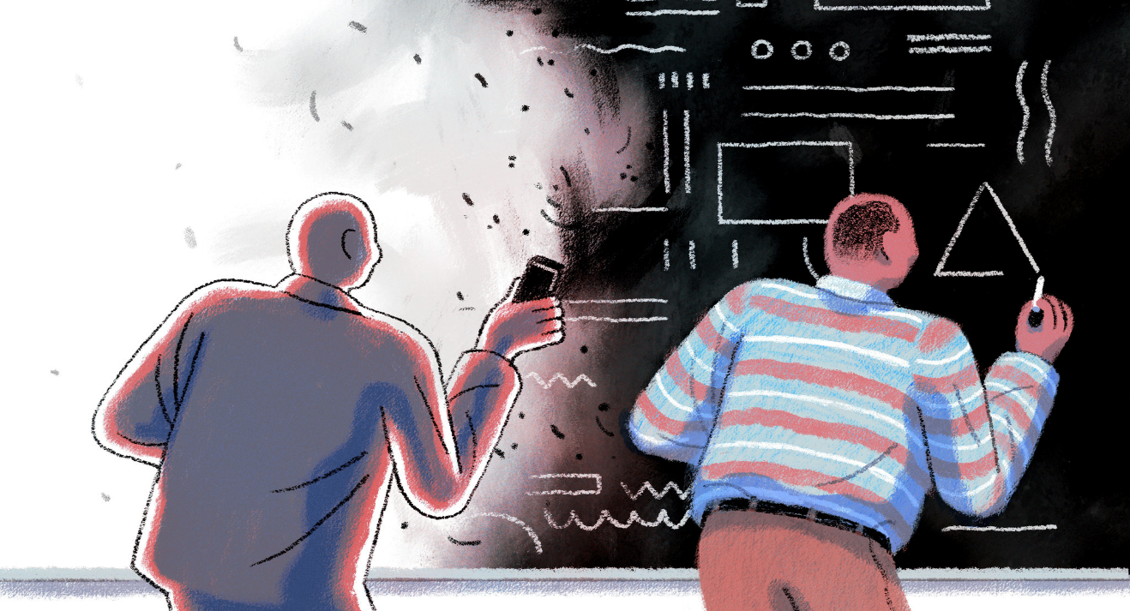
Rejection of scientific evidence

Slide 60
Brexit(s)
Evolution
  (Indian HE Minister)
Climate change
Vaccines
Our world is flat

Slide 62
Brexit(s)
Evolution
Climate change
Vaccines
Our world is flat
Historical events and facts
Academia has lost credibility, convincing power and respect

Slide 63
Critical thinking & respect for scientific evidence
Distinguish between real evidence and fabricated information (truth-seeking skills)
Reinstate academic tradition of free and fair debates, undermined by relativism and political correctness
Rebuild trust in academics and science
Improve communication channels between TEIs and Society

Slide 64


Slide 65
The pursuit of truth
By decree?
Or regaining the trust of the public?

Slide 66
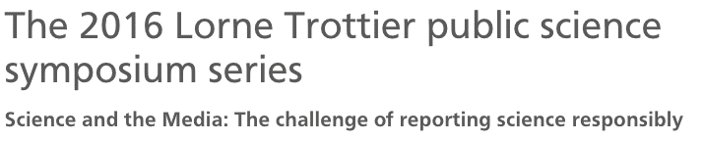
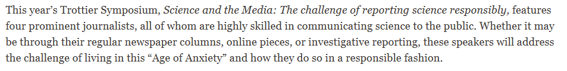

McGill University (Canada)

Slide 67
Conclusion:
To Trust or Not to Trust…

Slide 73
Too much trust?
FAA has delegated key security decisions to Boeing
Internal culture of hastiness & cutting corners (profit-driven)
Ignoring safety advice from key internal actors

Slide 74

Finding the Right Balance?

Slide 75
Conceptualizing accountability options (Stensaker & Maasen)
 | Hard | Soft
Rational / Instrumental | Legal & financial regulations / Accreditation | Audit, evaluation, reporting, strategic planning
Normative / Cognitive | League tables | Strategic advisory boards, partnerships, branding

Slide 76
Innovative features
Don’t only enforce standards of the past, but also recognize innovations in curriculum, pedagogy, assessment and degree configuration
Focus on outcomes and added value
  Learning achievement
  Competencies acquired
  Equity filter for success, not only access

Slide 77
Integrate valid elements of new accountability instruments
Voice of the students (student engagement)
Voice of society (labor market / employers)
Recognition of new credentials
Use the power of predictive analytics

Slide 78
Thriving under disruption
Hard to measure results in a shifting environment
  Rely on multiplicity of measures
Accountability as partnership rather than regulations
Partnership not fueled by contract but based on trust

Slide 79
Cultivate and strengthen what makes QA unique
Intellectual and institutional independence
Flexibility
Collaboration
  By and for the members
  In partnership with all stakeholders and partners

Slide 80
Trust
Trust is powerful
Trust is fragile
Trust is about truth
Trust is based on respect

Slide 81
You won’t let me down, will you?

