Slide 1
Academic Integrity
Associate Professor Cath Ellis (PFHEA)

Slide 2
Academic Integrity
Educational Integrity
Research Integrity

Slide 3
Structural integrity is the ability of an item … to hold together under a load, including its own weight, without breaking or deforming excessively.
It assures that the construction will perform its designed function during reasonable use, for as long as its intended life span.
Items are constructed with structural integrity to prevent catastrophic failure, which can result in injuries, severe damage, death, and/or monetary losses.
I ask the students: “Do you have structural integrity?”
Today I ask: “What about us?”
https://en.wikipedia.org/wiki/Structural_integrity_and_failure

Slide 4
Integrity should be at the heart of everything we do
Not just what we say

Slide 5
We have a problem: Contract Cheating
A student gets someone else to produce academic work on their behalf and then submits it to an educational institution as if it were theirs.
1 Friends and Family
3 ‘Legitimate’ learning sites
Micro tutoring sites
2 Academic Custom Writing sites
Discussion sites
4 Legitimate non-learning sites
Social Media
Auction sites
5 Paid exam takers
File sharing sites
Two-sided markets
Writing purchase sites
Parents
Girl/boyfriend
Mates
Live
Virtual
Labour and outsourcing sites

Slide 6
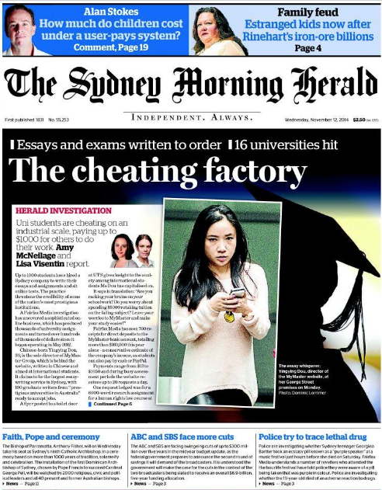
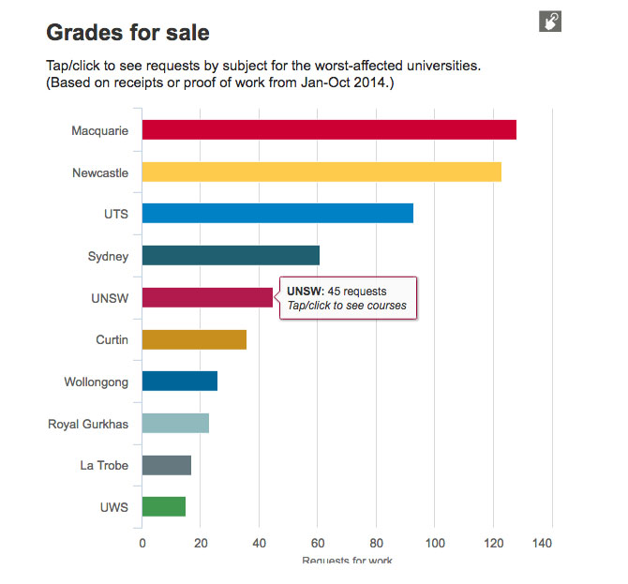
Wednesday November 12, 2014

Slide 7
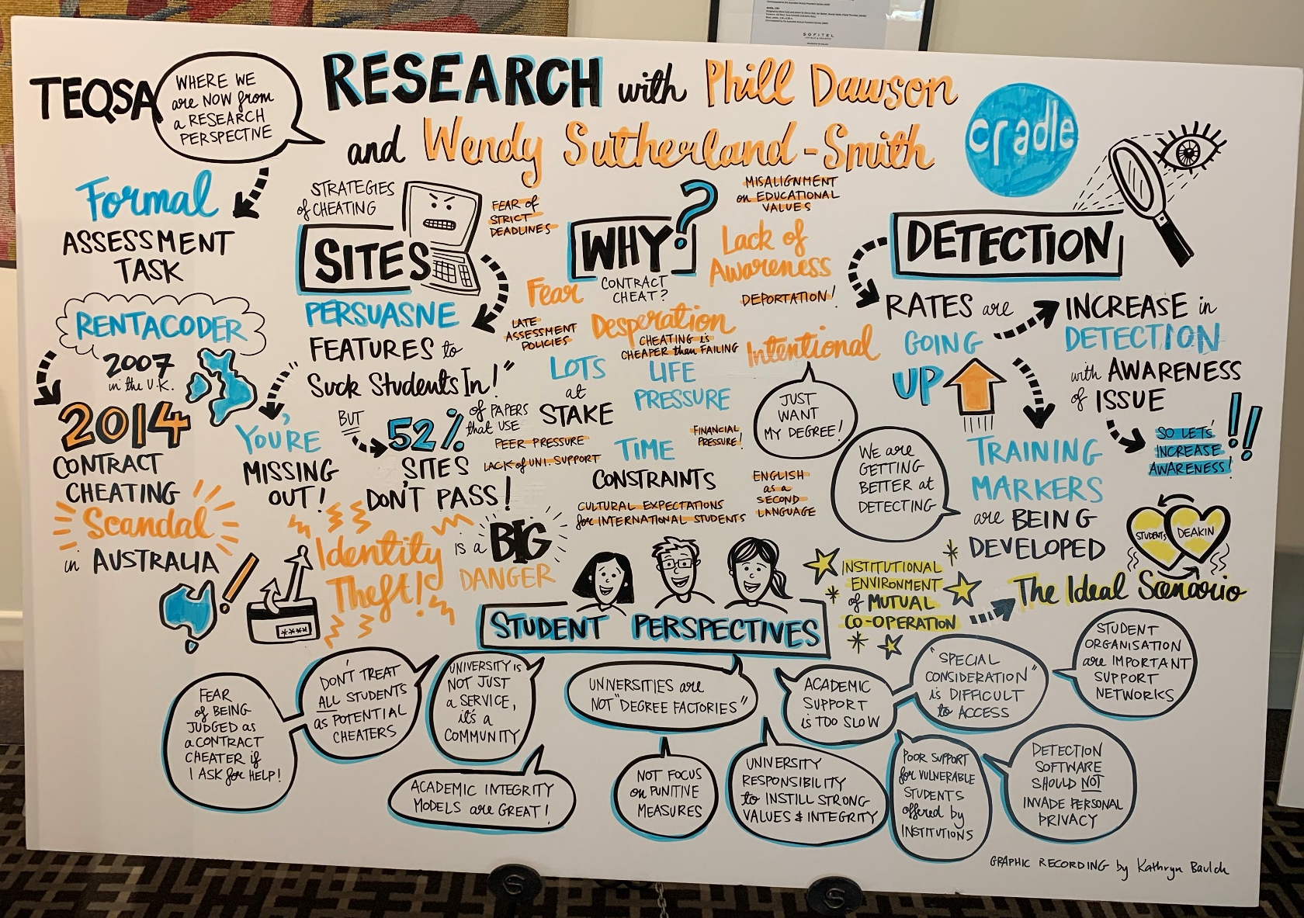

Slide 8
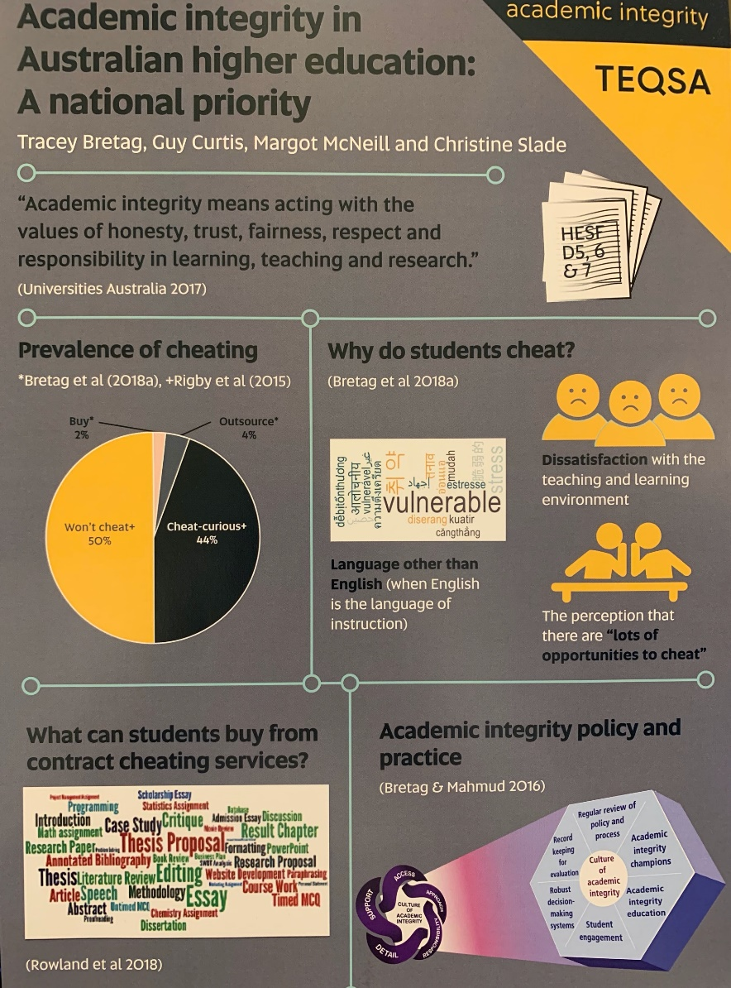
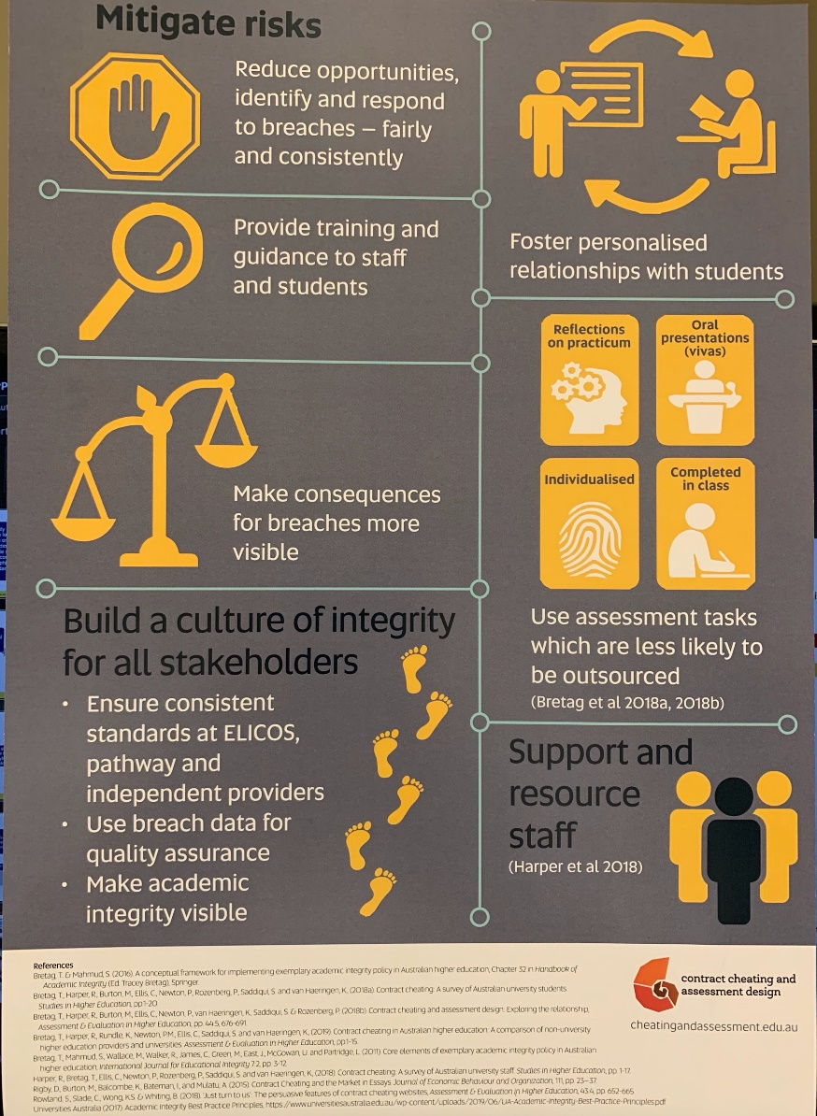
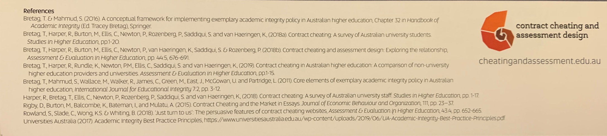

Slide 9
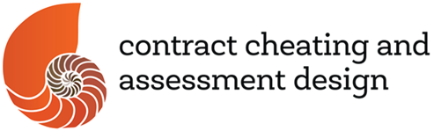

6% of students admit to having engaged in 1 or more contract cheating behaviours
How many would this be at your institution?
How many is this nationally? Internationally?
Detection ‘plimsoll line’. Is anyone there yet?
Tracey Bretag, Rowena Harper, Michael Burton, Cath Ellis, Philip Newton, Pearl Rozenberg, Sonia Saddiqui & Karen van Haeringen (2019) Contract cheating: a survey of Australian university students, Studies in Higher Education, 44:11, 1837-1856, DOI: 10.1080/03075079.2018.1462788

Slide 10
155,921,989

Slide 11
Happening under our noses
Largely undetected
Incidence
Detection
GAP
This will not diminish…
…until this starts to increase.

Slide 12
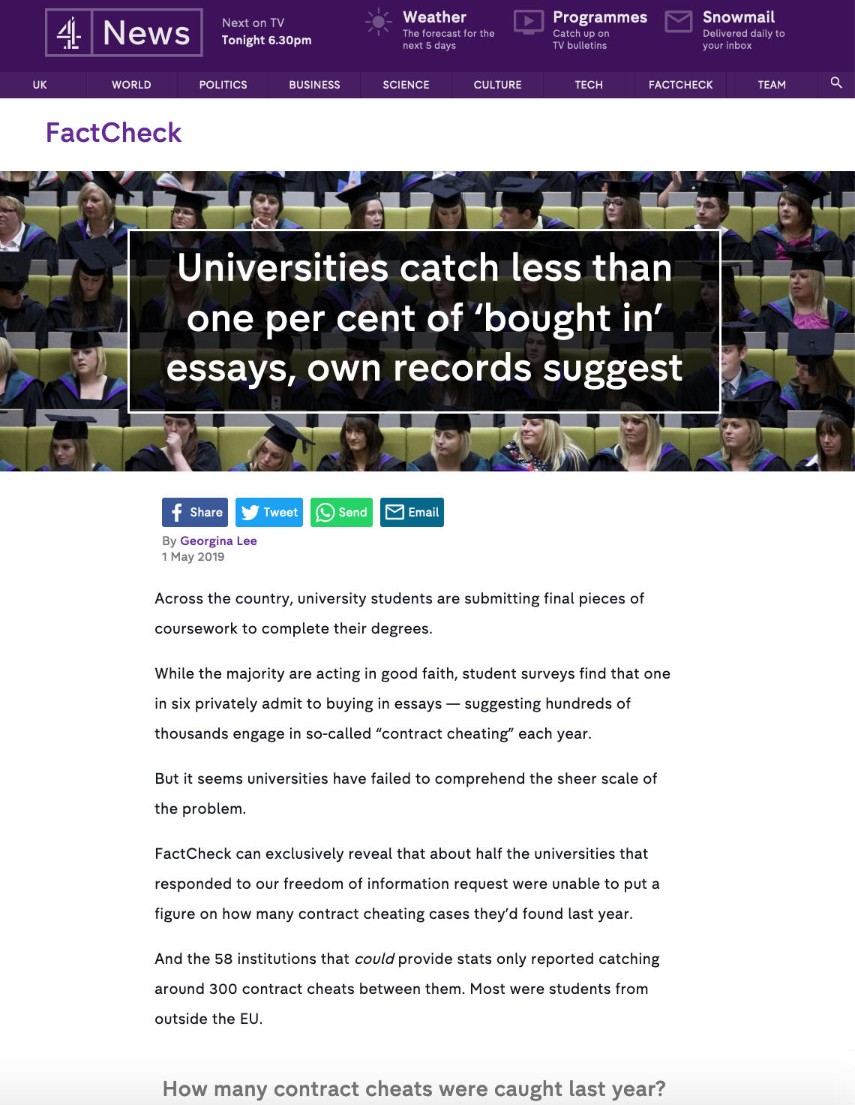
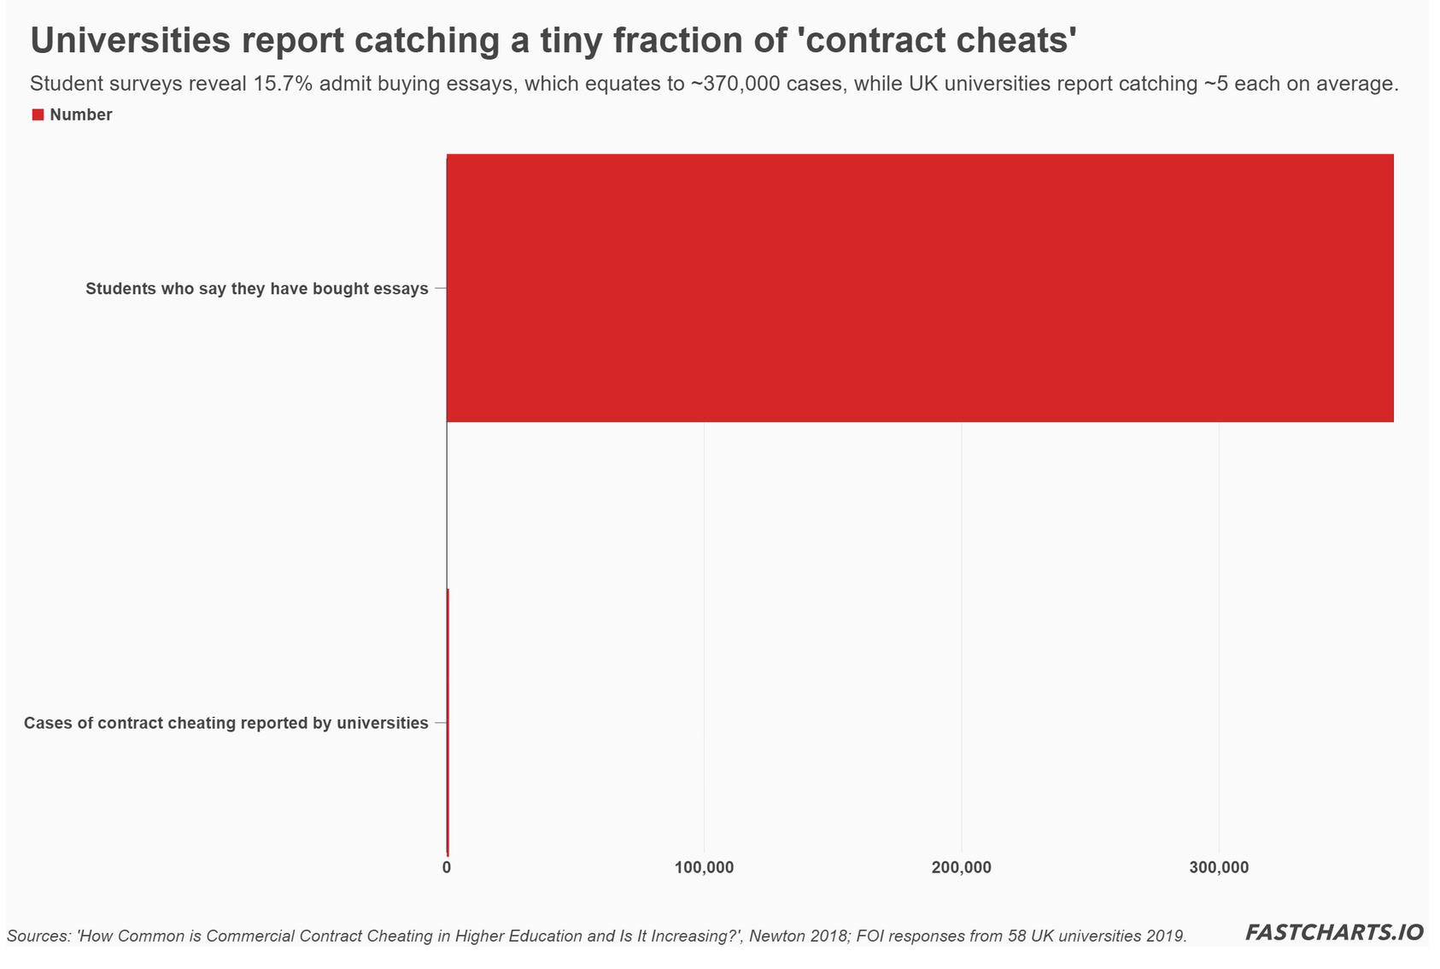
Georgina Lee 1 May 2019
Channel 4 Fact Check

Slide 13
Two thirds of respondents reported they had marked a piece of work that they suspected had been written by someone other than the student
We surveyed over 1100 academic staff about their experiences with Contract Cheating
Only half of them went on to report their suspicion to an academic integrity decision maker
Rowena Harper, T. Bretag, C. Ellis, P. Newton, P. Rozenberg, S. Saddiqui & K. van Haeringen (2019) Contract cheating: a survey of Australian university staff, Studies in Higher Education, 44:11, 1857-1873, DOI: 10.1080/03075079.2018.1462789

Slide 14
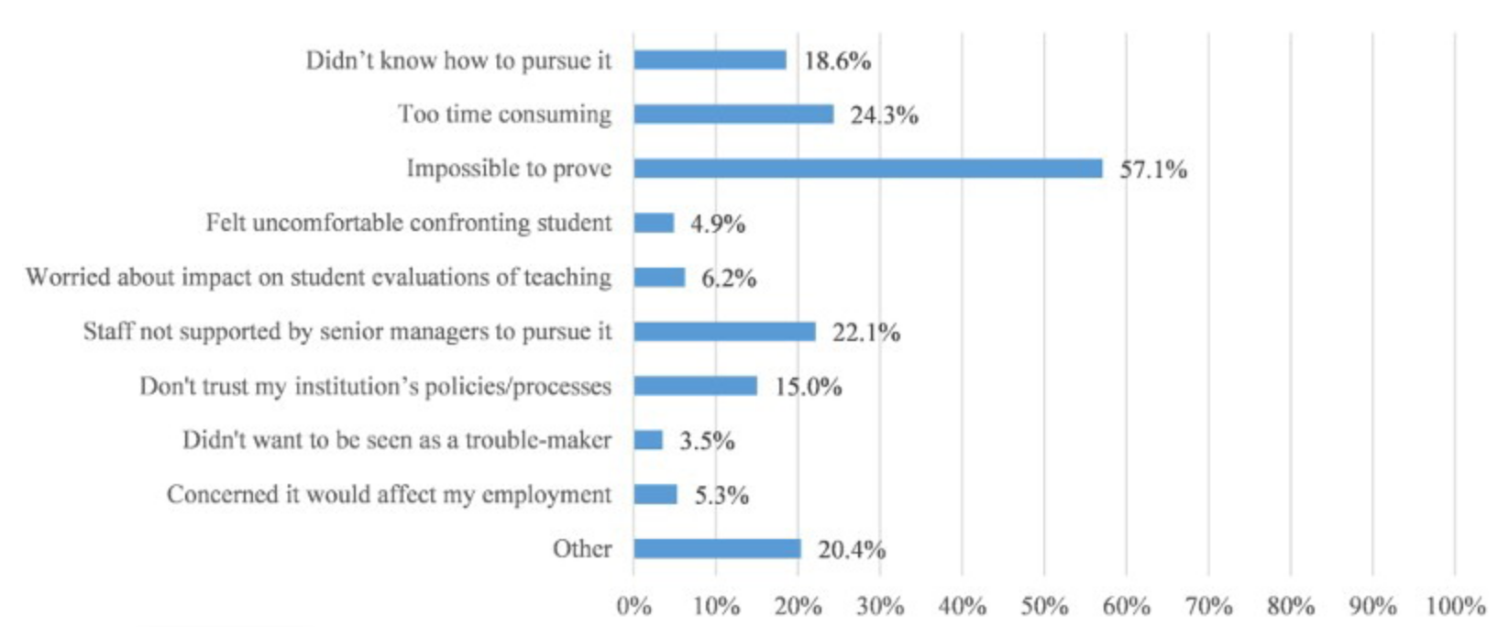
Rowena Harper, T. Bretag, C. Ellis, P. Newton, P. Rozenberg, S. Saddiqui & K. van Haeringen (2019) Contract cheating: a survey of Australian university staff, Studies in Higher Education, 44:11, 1857-1873, DOI: 10.1080/03075079.2018.1462789

Slide 15

Single most obvious opportunity to cheat
No or low detection
Tracey Bretag, Rowena Harper, Michael Burton, Cath Ellis, Philip Newton, Pearl Rozenberg, Sonia Saddiqui & Karen van Haeringen (2019) Contract cheating: a survey of Australian university students, Studies in Higher Education, 44:11, 1837-1856, DOI: 10.1080/03075079.2018.1462788

Slide 16
Contract Cheating is designed to evade detection
Low or no detection affects students’ perception of risk
May lead students to think it is being ignored or is condoned by institutions and teachers

Slide 17
Detection can be improved
Awareness raising¹
Training of markers²
Use of tools (eg. Turnitin’s Authorship tool)³
Evidence hiding in plain sight (eg. MyMaster)
¹Dawson, P., & Sutherland-Smith, W. (2018). Can markers detect contract cheating? Results from a pilot study. Assessment & Evaluation in Higher Education, 43(2), 286–293. https://doi.org/10.1080/02602938.2017.1336746
²Dawons, P. & Sutherland-Smith, W. (2019) Can training improve marker accuracy at detecting contract cheating? A multi-disciplinary pre-post study, Assessment & Evaluation in Higher Education, 44:5, 715-725, DOI: 10.1080/02602938.2018.1531109
³Dawson, P, Sutherland-Smith, W. & Ricksen, M. (2019) Can software improve marker accuracy at detecting contract cheating? A pilot study of the Turnitin authorship investigate alpha, Assessment & Evaluation in Higher Education, DOI: 10.1080/02602938.2019.1662884

Slide 18
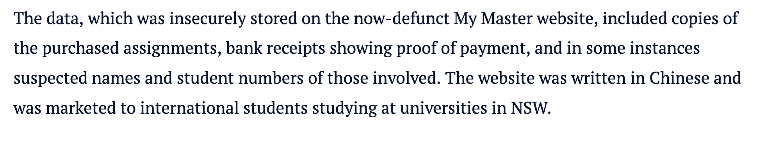
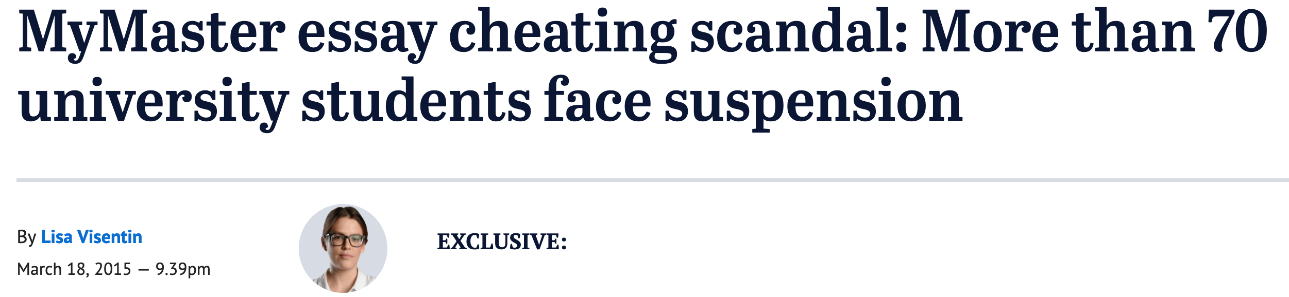

Slide 19
HE Providers
Other educational sectors
Leadership
Research led educational sector
Empirical evidence
We are in the business of expanding Knowledge
Partnership
Partnership
HE Regulators
Regulators of other sectors
Leadership

Slide 20
There are many potential detection approaches…
Prioritise detection approaches that:
…but we have a finite amount of time, energy and resource
are highly probative
are scalable and sustainable
address contract-cheating behaviours in both STEM and HASS
smash the business models of contract cheating providers
Ellis, C., Zucker, I.M. & Randall, D. The infernal business of contract cheating: understanding the business processes and models of academic custom writing sites. Int J Educ Integr 14, 1 (2018) doi:10.1007/s40979-017-0024-3

Slide 21
We need to address the perverse incentives not to report
Rowena Harper, T. Bretag, C. Ellis, P. Newton, P. Rozenberg, S. Saddiqui & K. van Haeringen (2019) Contract cheating: a survey of Australian university staff, Studies in Higher Education, 44:11, 1857-1873, DOI: 10.1080/03075079.2018.1462789

Slide 22
This needs to be taken seriously
This needs to be properly resourced and supported
This needs courage and deeds not just words
It is a ‘must have’ not a ‘good to have’
Centralise the investigative and administrative compliance function
Make this someone’s job
Give them tools to make them more efficient and effective
Find your academic staff who are passionate about this and support and reward them

Slide 23
Wednesday November 12, 2014

Slide 24
Structural integrity is the ability of an item … to hold together under a load, including its own weight, without breaking or deforming excessively.
It assures that the construction will perform its designed function during reasonable use, for as long as its intended life span.
Items are constructed with structural integrity to prevent catastrophic failure, which can result in injuries, severe damage, death, and/or monetary losses.
Do we have structural integrity?
https://en.wikipedia.org/wiki/Structural_integrity_and_failure

