Slide 1
4th Annual
Conference
27-29 November 2019

Slide 2

Plenary Session
Time: 9:00am – 10:45am
Grand Ballroom
State of the Sector 2019
Anthony McClaran, TEQSA CEO
WIFI Network: Sofitel Events Wifi Password: TEQSA Join the conversation: #TEQSA2019

Slide 3
State of the Sector 2019
Cycle 7 Sector Matrix 2019*
 |  | Risk to Financial Position |  |  | TOTAL
 |  | Low | Moderate | High
Risk to Students | High | 3 | 7 | 3 | 13
 | Moderate | 21 | 16 | 9 | 46
 | Low | 72 | 15 | 5 | 92
TOTAL |  | 96 | 38 | 17 | 151
*subject to minor change
WIFI Network: Sofitel Events Wifi Password: TEQSA Join the conversation: #TEQSA2019

Slide 4
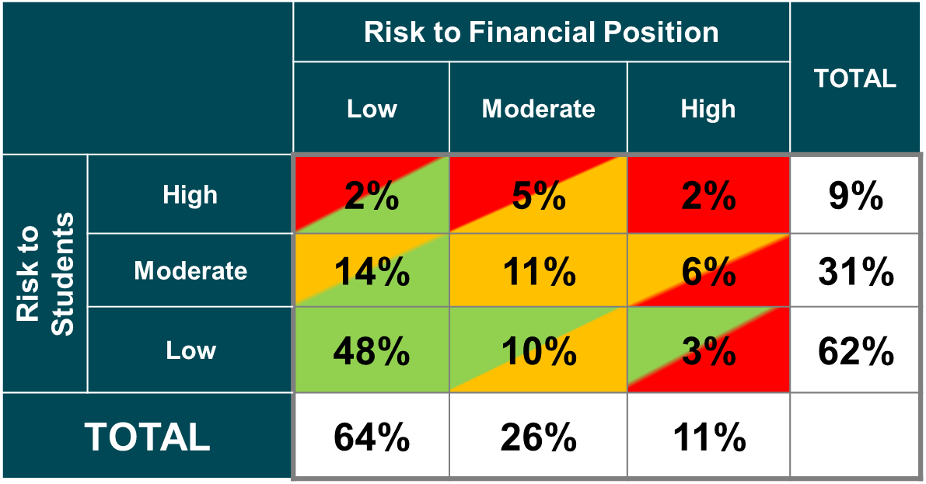
State of the Sector 2019
Cycle 7 Sector Matrix 2019*
*subject to minor change
WIFI Network: Sofitel Events Wifi Password: TEQSA Join the conversation: #TEQSA2019

Slide 5
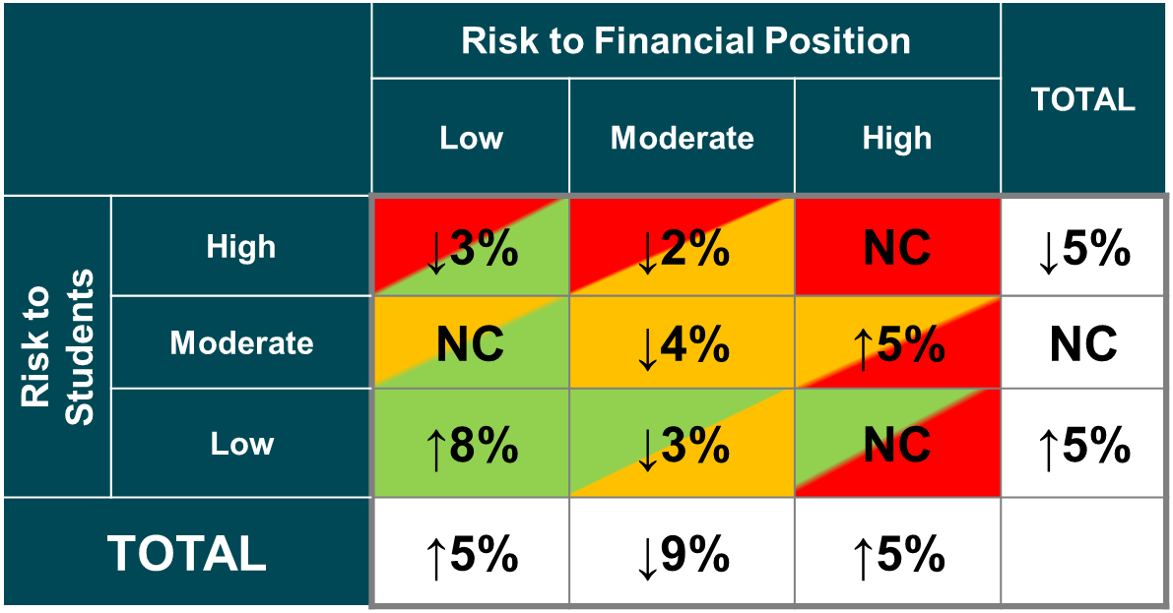
State of the Sector 2019
Cycle 7 Sector Matrix 2019*
*subject to minor change
WIFI Network: Sofitel Events Wifi Password: TEQSA Join the conversation: #TEQSA2019

Slide 6
Plenary Session
Time: 9:00am – 10:45am
Grand Ballroom
State of the Sector 2019
Anthony McClaran, TEQSA CEO
WIFI Network: Sofitel Events Wifi Password: TEQSA Join the conversation: #TEQSA2019

Slide 7

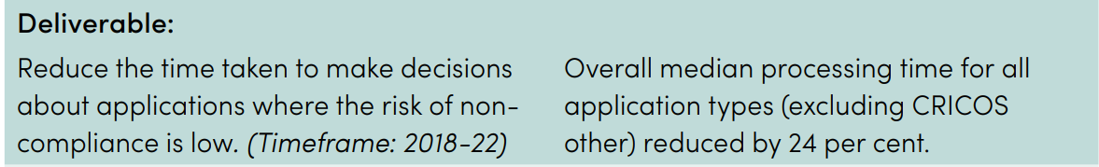
State of the Sector 2019
TEQSA 2018-2019 Annual Report
WIFI Network: Sofitel Events Wifi Password: TEQSA Join the conversation: #TEQSA2019

Slide 8
State of the Sector 2019
2019 Stakeholder Survey
TEQSA was rated as good / excellent by:
89% for: Available materials explaining regulatory policies and processes
88% for: Usefulness of information on the HESF (Threshold Standards)
86% for: Treating with politeness and respect
80% for: Application process and clarity of application guide
77% for: Helping the sector as a whole to protect students
76% for: Overall regulatory performance, in assuring the quality of Australian higher education
73% risk: In relation to being open, transparent and consistent in their dealings with us
WIFI Network: Sofitel Events Wifi Password: TEQSA Join the conversation: #TEQSA2019

Slide 9
Staffing, Learning Resources and Educational Support
Technology-Enhanced Learning
TEQSA and the Australian Qualifications Framework
Third-Party Arrangement
Transnational Higher Education – Inbound
Varying a Period of Registration or Accreditation
Wellbeing and Safety
Work-Integrated Learning
Workforce Planning
TEQSA’s 28 Guidance Notes
Academic Governance
Academic Integrity
Academic Leadership
Academic Quality Assurance
Changes in a course of study that may lead to accreditation as a new course
Corporate Governance
Course Design (incl Learning Outcomes and Assessment)
Credit and Recognition of Prior Learning
Determining Professional Equivalence
Diversity and Equity
ELICOS Direct Entry
External Referencing
Financial Assessment
Financial Standing
Grievance and Complaint Handling
Joint and Dual Awards
Nested Courses
Research and Research Training
Scholarship
WIFI Network: Sofitel Events Wifi Password: TEQSA Join the conversation: #TEQSA2019

Slide 10
State of the Sector 2019
Sector-wide issues
Promoting academic integrity and addressing contract cheating
Addressing sexual assault and sexual harassment
Assessments of English language competency in admissions of international students;
  the 2017 student success rate for international students was 88.85 per cent compared with 84.08 per cent for domestic students,
  a combined adjusted attrition rate for international students of 9.76 per cent compared with 16.28 per cent for domestic students in 2017.
4. Admissions transparency
WIFI Network: Sofitel Events Wifi Password: TEQSA Join the conversation: #TEQSA2019

Slide 11
State of the Sector 2019
Major external reviews
Provider categories
Australian Qualifications Framework
Performance based funding
Foreign interference – [insert code title]
Academic freedom, and freedom of speech – [insert Robert French title]
WIFI Network: Sofitel Events Wifi Password: TEQSA Join the conversation: #TEQSA2019

Slide 12
State of the Sector 2019
Streamlining and reducing regulatory burden
Extensions to registration and accreditations
‘Core minus’
‘Core plus’
Smoothing
Course reviews with independent experts
Promoting greater self-assurance
Internal:
  LEAN
  Case management review
WIFI Network: Sofitel Events Wifi Password: TEQSA Join the conversation: #TEQSA2019

Slide 13
4th Annual
Conference
27-29 November 2019

