Slide 1

Acknowledgement of Country
I would like to acknowledge and pay respect to the traditional owners of the land on which we meet; the Bidjigal and Gadigal people of the Eora Nation. It is upon their ancestral lands that NIDA is built. As we share our own knowledge, teaching and learning within this environment, may we also pay respect to the knowledge embedded forever within the Aboriginal Custodianship of Country.

Slide 2
Opening Remarks
Professor Nicholas Saunders, TEQSA Chief Commissioner

Slide 3
TEQSA’s Risk Based Regulation of the Australian Higher Education Sector
Risk Workshop – Sydney 6th September 2019
Gregory Simmons
Director, Policy and Analysis

Slide 4


Slide 5


Slide 6


Slide 7

Data Consultation
TEQSA is consulting on how we collect data.
Consultation also closes September 20.
https://www.teqsa.gov.au/latest-news/publications/integrating-provider-information-request-higher-education-data-collection

Slide 8
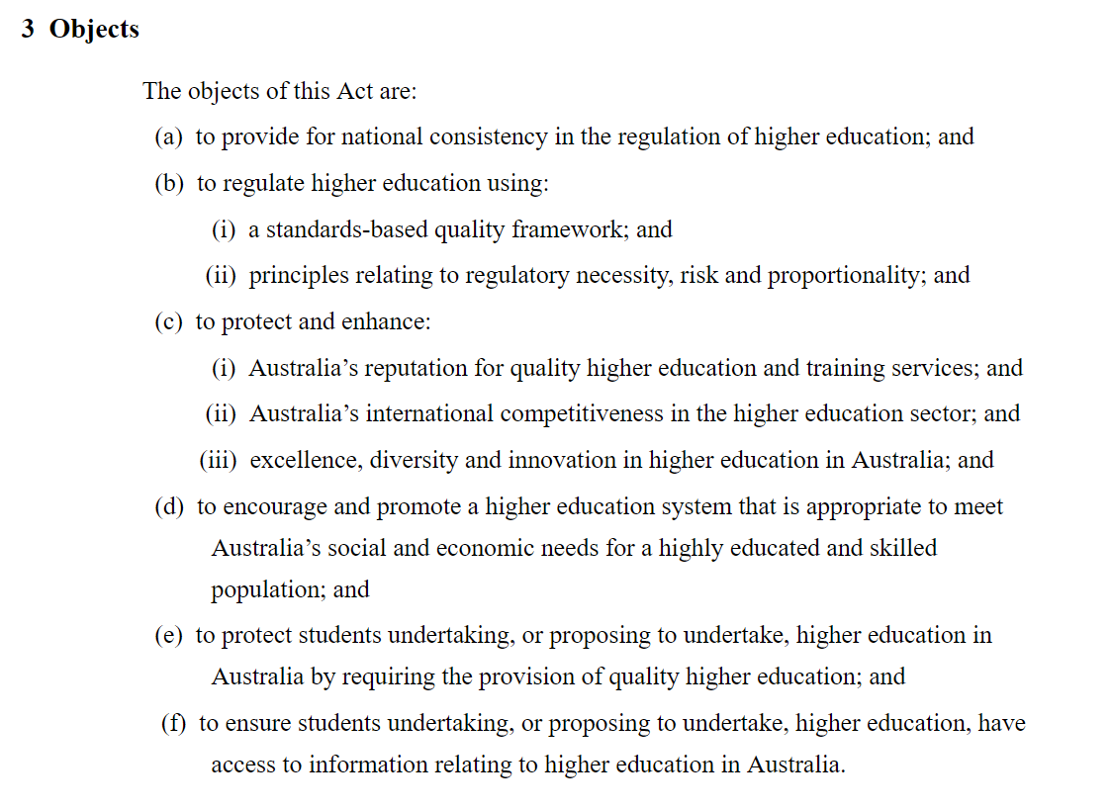
TEQSA is a risk based regulator

Slide 9
Provider risk is bigger than an annual risk assessment
Risk monitoring includes:
  Annual risk assessments
  Provider visits ( inspections/investigations)
  Issues identified during compliance assessments
  Complaints
  Media monitoring
  Material Change
  Data mining
  Referrals / other intelligence

Slide 10
Risks are not a breach of the standards
Risk assessments inform other regulatory assessments
Decisions relating to a providers registration or course accreditation follow an examination of a providers compliance with the standards.

Slide 11
TEQSA might identify risks which apply to a group of providers or to the sector as a whole.
These sector wide or thematic risks require a different type of treatment.

Slide 12
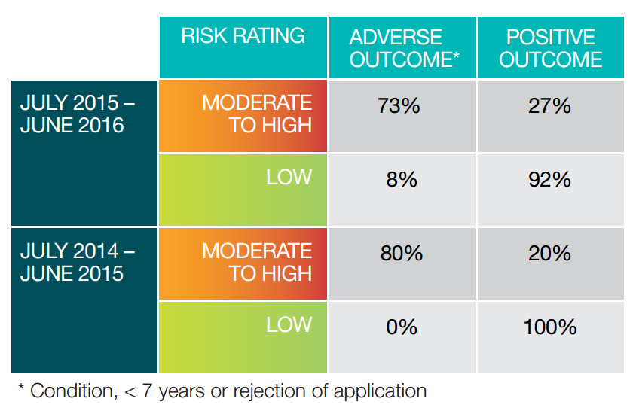
Risk ratings and outcomes of renewal of registration

Slide 13
Today is about both types of risk
Session 1 – Review of the current Risk Assessment Framework. Your chance to help us plan any changes (small or significant)
Session 2 – What are the big risk issues for the sector? And how should TEQSA deal with them.

Slide 14
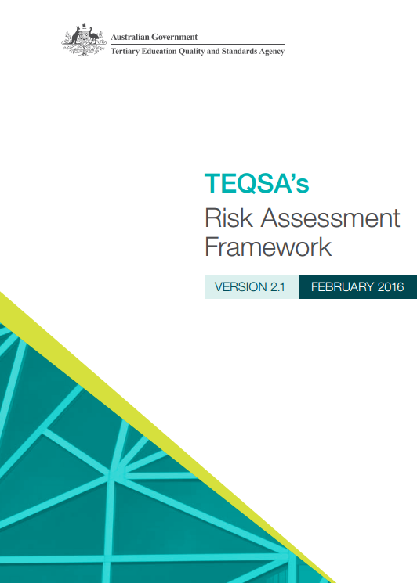
Risk assessment framework

Slide 15
Why does TEQSA conduct provider risk assessments?
Monitor and highlight key aspects of providers’ operations during registration periods.
Inform a differentiated approach to evidence and reporting requirements in assessment processes, such as renewal of registration.
Support case managers and providers to engage in early discussion about emerging issues prior to any scheduled assessment process.
It serves as a device to develop a deeper understanding of providers, their own risk management strategies and their performance improvement initiatives.

Slide 16
Re-registration: Core +
Core
Assessment against core set of 7 standards
Student outcomes & support
Internal Systems for quality assurance
Extension
Assessment of additional targeted areas based on risk and history:
e.g. financial
e.g. third party
e.g. scholarship
Extension based on:
Overall moderate or high risk to students or financial position
Unresolved regulatory issue(s)
Limited or no history with TEQSA
+
*New registrations are assessed against all standards

Slide 17
What does TEQSA expect provider to do with their risk assessment?
Address any areas highlighted and provide TEQSA with any further relevant information around relevant improvements, strategies or plans.
Regardless of the risk findings we invite a response and this is your opportunity to provide TEQSA with any relevant information you might have. Its our annual touch point with providers.
Correct any errors of fact through a response to TEQSA.
We would expect provider boards / councils to consider the report on an annual basis.

Slide 18
Annual Risk Cycle Process
Data is collected, validated and stored
Pre-cycle preparation
Risk Assessment cycle undertaken
Post cycle analysis
Continuous system improvement

Slide 19
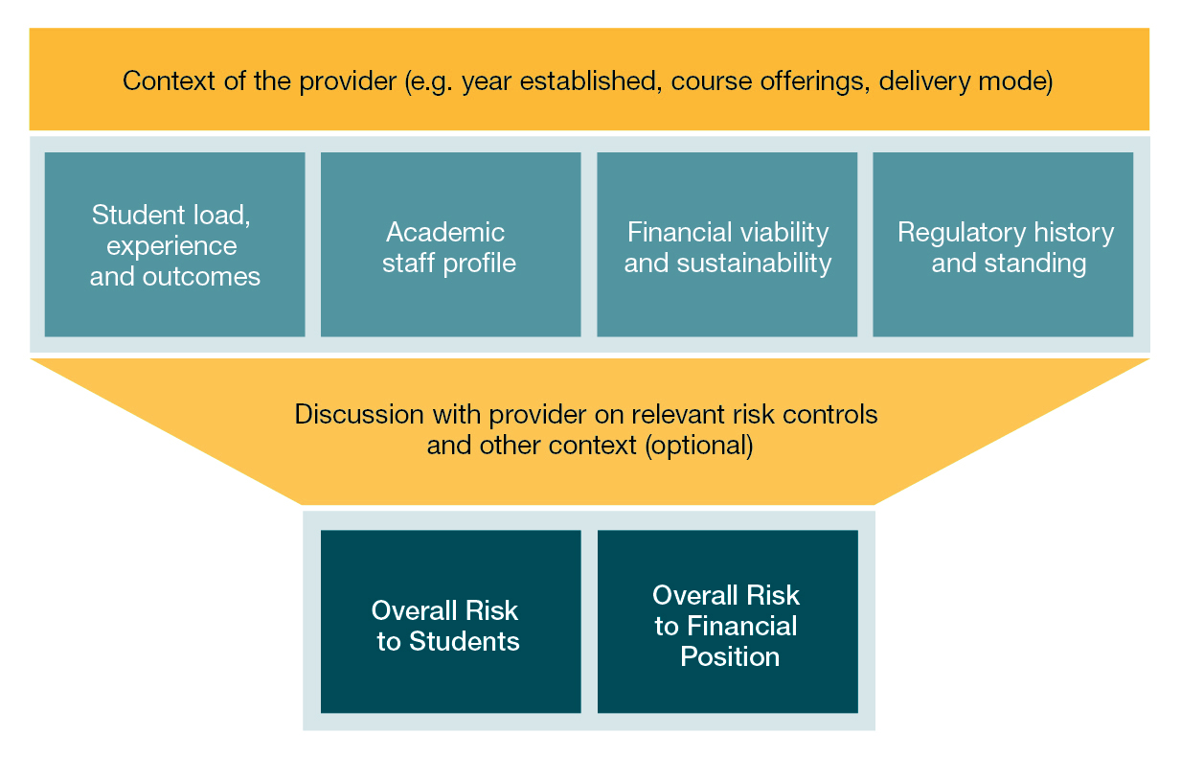
Key areas considered in risk assessment

Slide 20
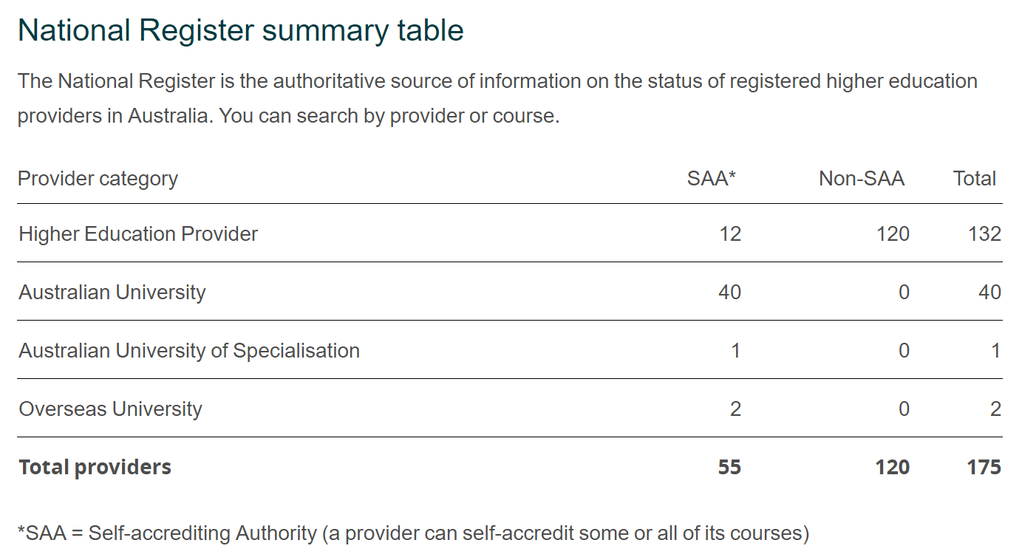
We have a diverse sector

Slide 21
Rating an indicator
Risk
Rating
Context
Regulatory History
Provider risk management
Risk thresholds
Analyst’s professional judgement

Slide 22
Finalising the Annual Risk Assessment
TEQSA risk analysts prepare a preliminary risk assessment for each registered provider.
The assessment is then finalised with the TEQSA case management team and signed off as final by the case teams Director.
Each provider is then sent a confidential risk assessment and asked to respond on any issues raised.
Responses are analysed by TEQSA risk analysts and risk ratings are adjusted if appropriate.
TEQSA then produce sector and sub-sector summaries, analyses trends, and decide on the parameters for its next risk cycle.

Slide 23
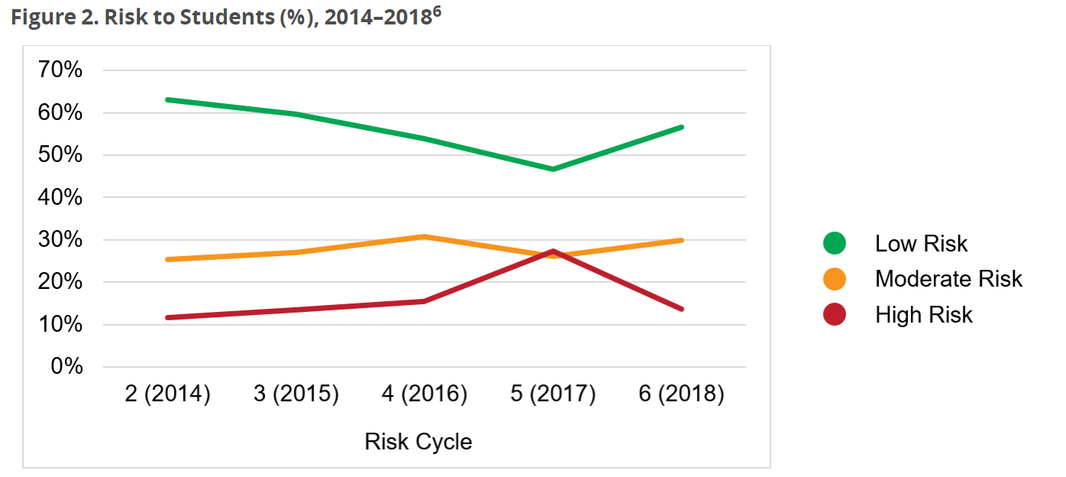

Slide 24
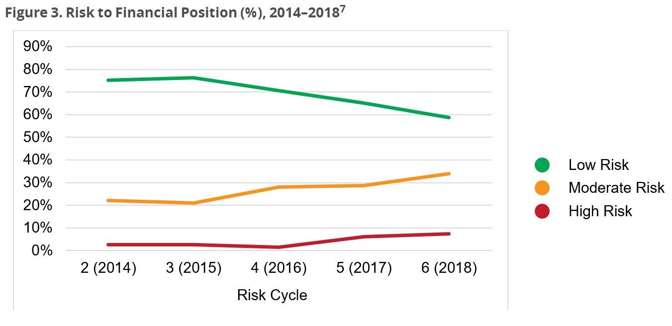

Slide 25
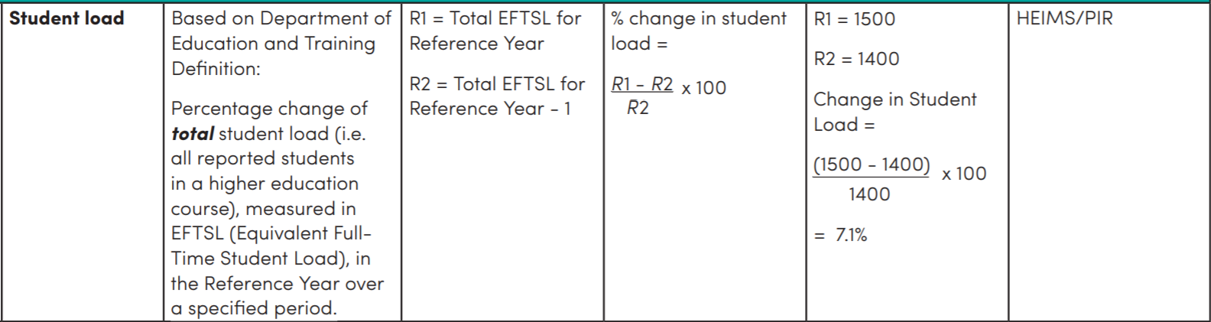
Student Load Indicator

Slide 26
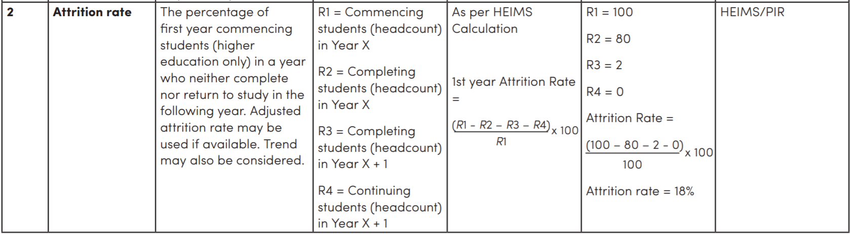
Attrition Indicator

Slide 27
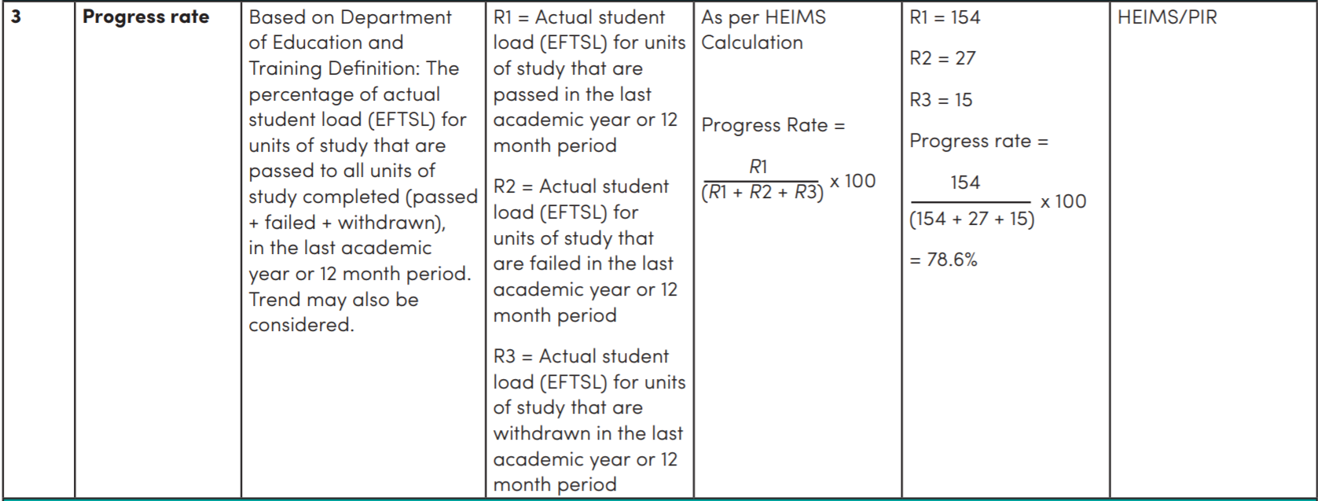
Progress Rate Indicator

Slide 28
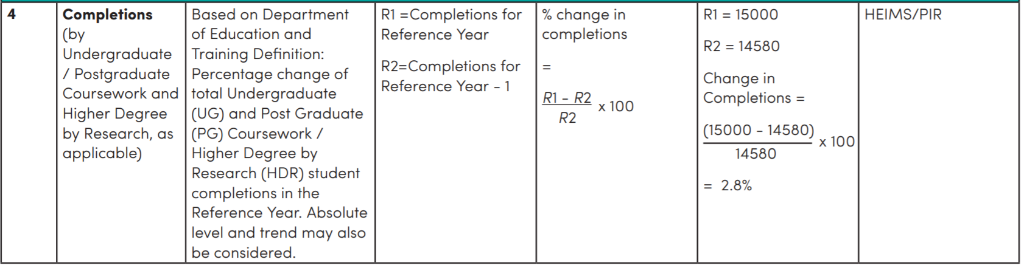
Completions Indicator

Slide 29
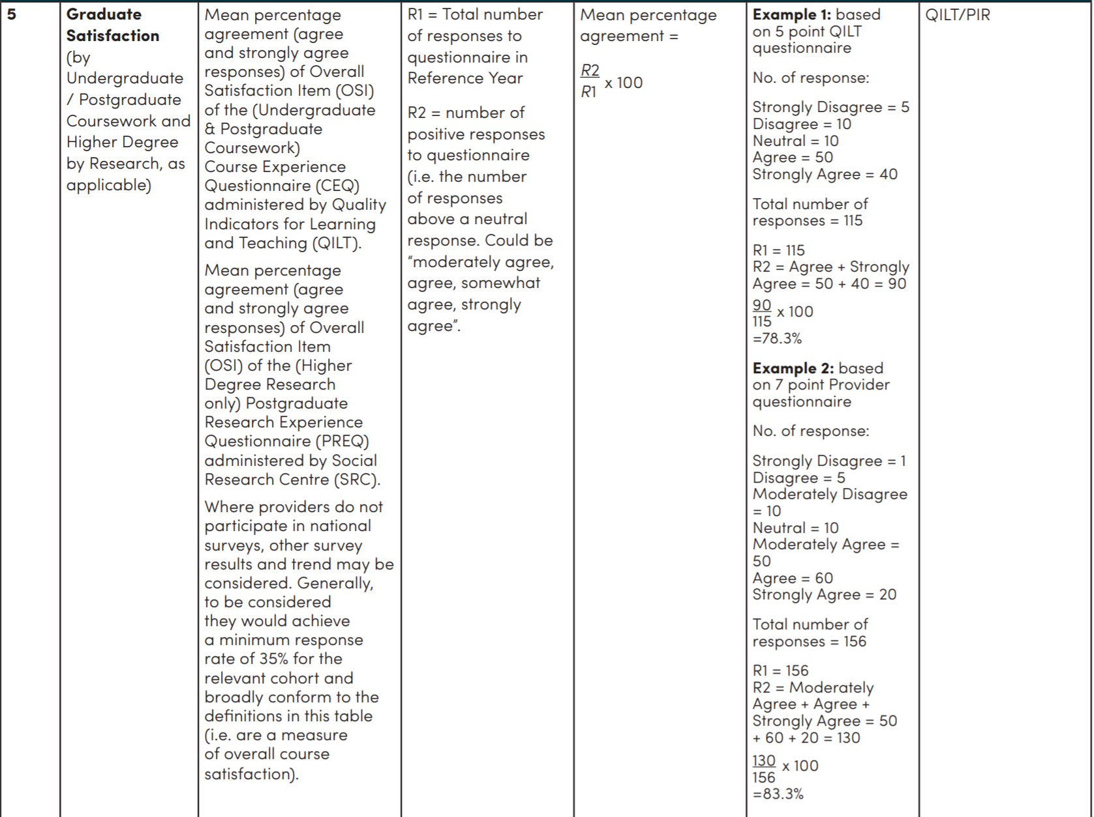
Graduate Satisfaction Indicator

Slide 30
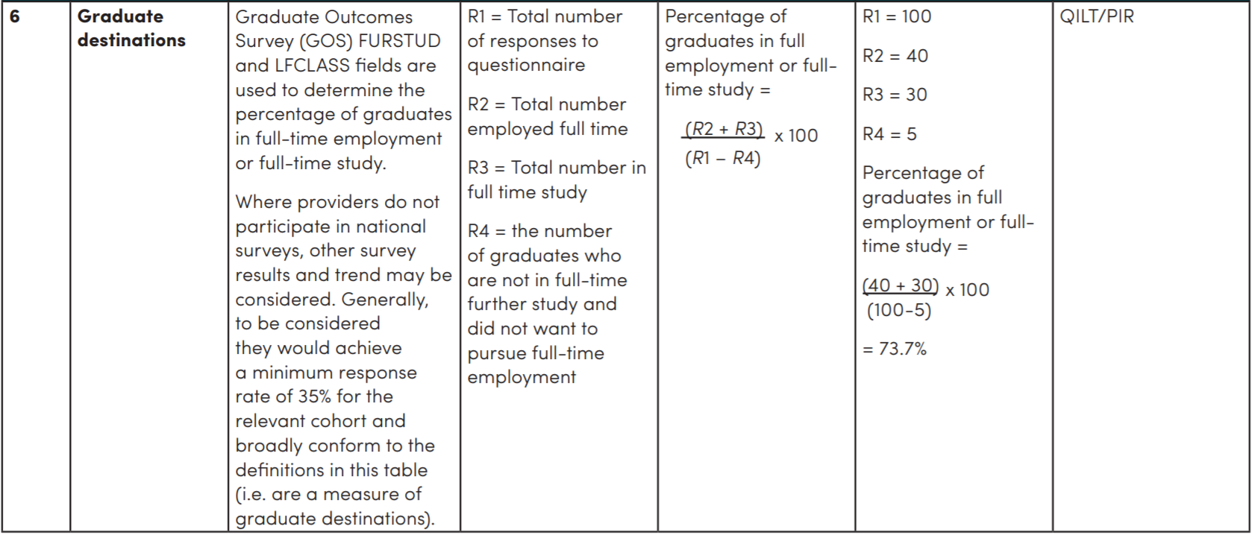
Graduate Destination Indicator

Slide 31
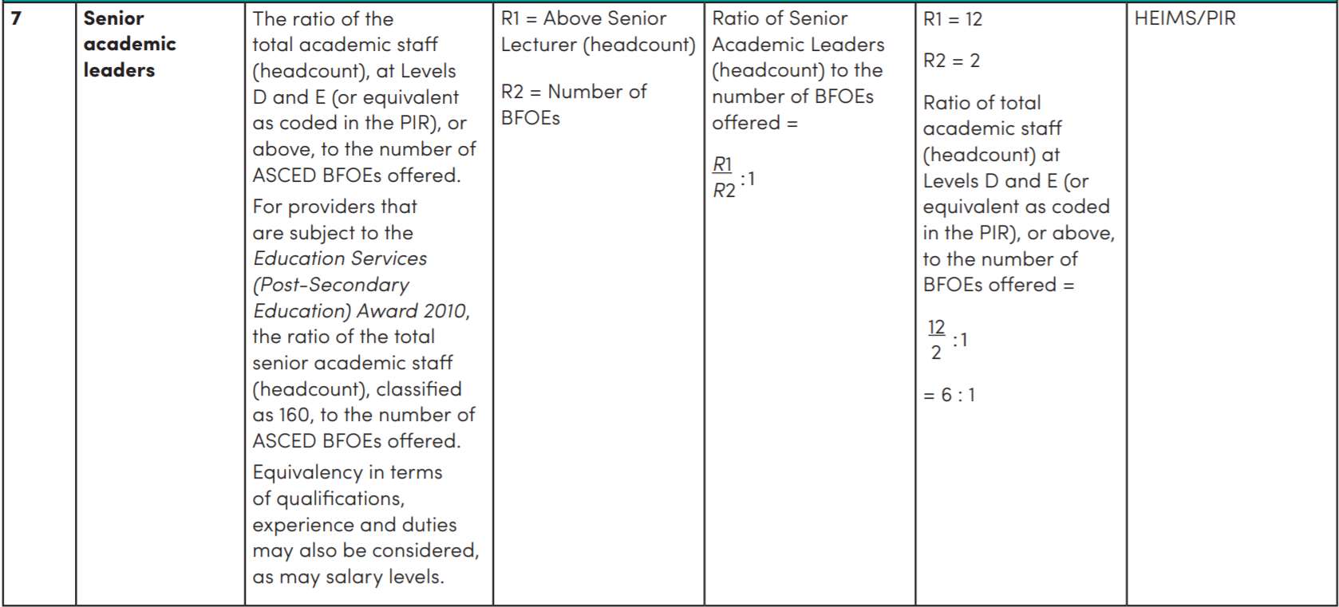
Senior Academic Leaders Indicator

Slide 32
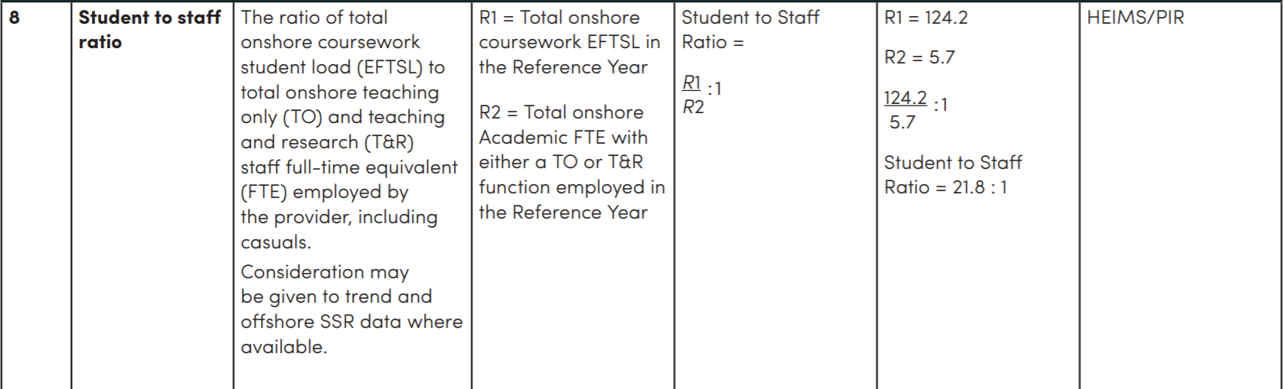
Student Staff Ratio Indicator

Slide 33
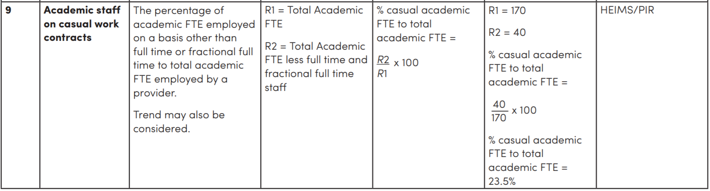
Academic Casual Percentage Indicator

Slide 34
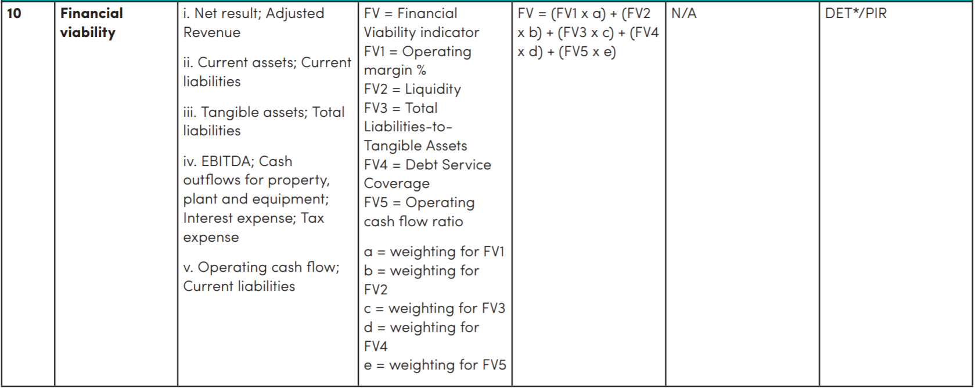
Financial Viability Indicator

Slide 35
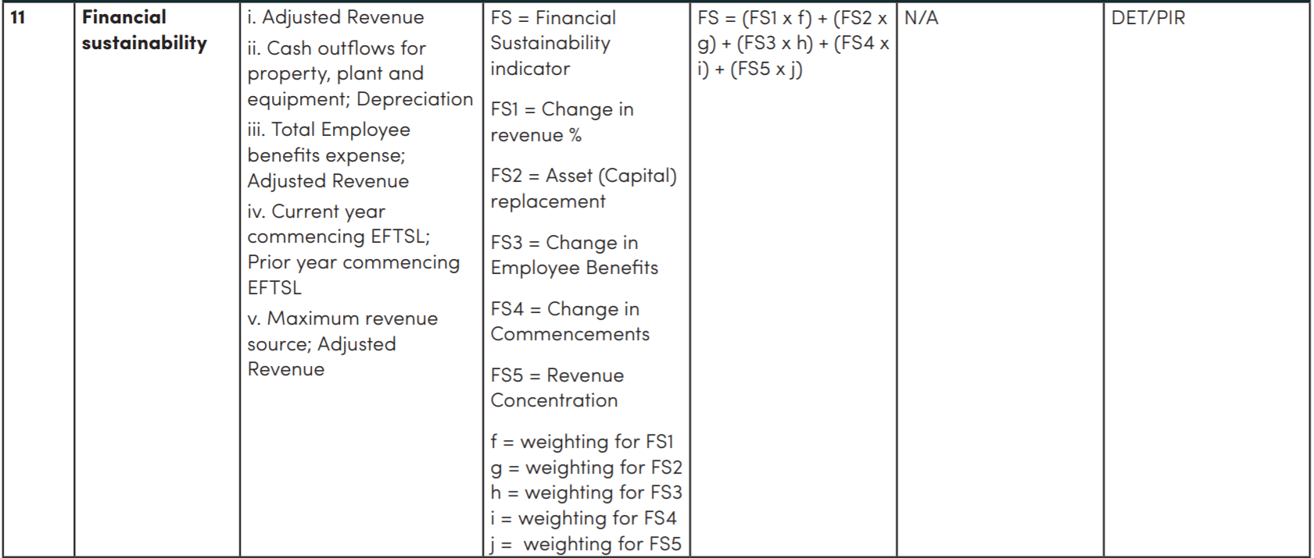
Financial Sustainability Indicator

Slide 36
Thank you. Any questions?
teqsa.gov.au
@TEQSAGov

Slide 37
10:45 am - 11:00 am | Morning Tea – Nancy Fairfax Foyer
Breakout Session 1 Critique the current Risk Assessment Framework 11.00 am - 12.00pm | Breakout Session 1 A: Ivany 1 (level 3) B: Ivany 2 (level 3) C: Reception Room (level 2) D: Graduate Studio (level 3)
 | Existing indicators (start, stop, continue, change) Contextual factors and provider responses (start, stop, continue, change) Previous regulatory history and use of other intelligence (start, stop, change, continue) Confidentiality, transparency and consistency (should we publish thresholds, provider performance data, should all providers receive a universal risk analysis or should we differentiate if so how?)
12:00 – 12:45pm | Lunch – Nancy Fairfax Foyer

Slide 38
12:45 pm - 1:30 pm | Breakout 1: Wrap Up – Parade Playhouse
Breakout Session 1 Beyond the Risk Framework – Sector Risks 1.30 pm - 2:30 pm | Breakout Session 2 A: Ivany 1 (level 3) B: Ivany 2 (level 3) C: Reception Room (level 2) D: Graduate Studio (level 3)
 | Identify emerging (or current) sector risks. Propose ways in which TEQSA can work with the sector to deal with these risks.
2:30 – 3:00 pm | Wrap up Session 2 – In breakout rooms
3:00 – 3:30 pm | Concluding Remarks – Parade Playhouse

