Slide 1
Academic integrity in Australian higher education:
A national priority
A series of workshops to foster a culture of academic integrity across the sector
Tracey Bretag, Guy Curtis, Margot McNeill and Christine Slade
2019/2020

Slide 2

Pre-workshop survey
Please read the Participant Information Sheet
Please sign the Consent Form
Please complete the pre-workshop survey – keep this for later, as you will need to complete the post-workshop survey

Slide 3
Outline of workshop
1. Defining academic integrity
2. TEQSA and the Higher Education Standards Framework
3. Model Statement of Commitment to Academic Integrity
4. Overview of academic integrity research and scholarship
5. Policies and procedures to promote and uphold academic integrity
6. Actions to mitigate foreseeable risks to academic integrity
7. Training and guidance for staff and students
8. Building a culture of integrity for all stakeholders
9. Links to references and resources

Slide 4
Defining academic integrity
Academic integrity means acting with the values of honesty, trust, fairness, respect and responsibility in learning, teaching and research.
  Universities consider that it is vital for students and all staff act in an honest way and take responsibility for their actions and every part of their work. Staff should be role models to students. Academic integrity is important for an individual’s and a university’s reputation.
  (Universities Australia 2017, adapted from Exemplary Academic Integrity Project 2013 and Fundamental Values of Academic Integrity 1998)

Slide 5
TEQSA and the Higher Education Standards Framework
5.2 Academic and Research Integrity
TEQSA will need to be satisfied that there is an institutional policy framework to maintain and support academic integrity of students and staff that is backed by processes and practices that implement institutional policies effectively. Providers will need processes for detecting and addressing instances of plagiarism and other forms of ‘cheating’.
From <https://www.teqsa.gov.au/hesf-domain-5>
Section 6.3 on Academic Governance makes it clear that academic bodies of the provider are responsible for maintaining oversight of academic and research integrity, including the monitoring of potential risks (Standard 6.3.2d)
Section 7.2 on Information for Prospective and Current Students requires providers to make information on and expectations of academic integrity available to students before their acceptance of an offer (Standard 7.2.2d).
Standard 7.3.3c also obliges providers to document and record responses to allegations of misconduct and breaches of academic or research integrity. This can be the basis for analysis and identification of recurring issues.
https://www.teqsa.gov.au/latest-news/publications/guidance-note-academic-integrity

Slide 6

Model statement of commitment to academic integrity
Model Statement – Department of Education and Training initiative, following recommendations from the Higher Education Standards Panel and feedback from the sector.
  Working group includes diverse stakeholders representing universities, Independent Higher Education Providers, peak bodies and students’ organisations
  Face-to-face consultation and focus groups to collegially develop the statement
  Model Statement originally conceived as similar to US styled ‘Honor Pledge’, but is now being designed to express mutual commitment to academic integrity by all stakeholders in higher education.
  Focuses on values, practices, shared responsibilities, consequences for breaches and recognition of individual and reputational risk.
  More than a statement – complemented by resources and ongoing dialogue.

Slide 7
Understandings of academic integrity
Discussion
How is academic integrity defined and promoted at your institution?

Slide 8
The research: prevalence of student cheating
Rates of self-reported cheating vary:
  46% (Smyth & Davis, 2004)
  67% (McCabe, 1992)
  72% (Brimble & Stevenson-Clarke, 2005)
Rates of self-reported plagiarism vary:
19% (Scanlon & Neuman, 2002)
26% (Ellery, 2008)
66% (Franklyn-Stokes & Newstead, 1995)
81% (Marsden, Carroll & Neill, 2005)
Rates of plagiarism in postgraduate work vary:
5% (Segal et al., 2010)
27% (McCullogh & Holmburg, 2005)
42.6% (Gilmore et al., 2010)
Rates of contract cheating are comparatively low:
3.5% - 7.9% (Curtis & Clare, 2017)
6% (Bretag et al 2018)
7% of non-university students (Bretag et al 2019)
8% (Foltynek & Kralikova 2017)

Slide 9
Who cheats?
Males (Kremmer et al, 2007; Bretag & Harper et al 2018)
Younger students (Brimble, 2016; Marsden et al 2005)
Business students (McCabe & Trevino, 1995; Smyth & Davis, 2004).
Engineering students are more likely to cheat than students from all the other disciplines (Marsden et al. 2005; Bretag et al 2018)
International EAL students - Note: it’s language rather than culture which influences behaviour (Bretag et al 2018)

Slide 10
Australian scholarship
2003 1st Asia Pacific Conference on Educational Integrity
  (2003, 2005, 2007, 2009, 2011, 2013, 2015, 2017)
2003 Asia Pacific Forum on Educational Integrity
2005 International Journal for Educational Integrity
2010 Academic integrity standards Project
2012 Exemplary Academic Integrity Project
  Other research projects on academic integrity – Victoria, Macquarie, Newcastle Universities.
2016 Contract cheating and assessment design project (Bretag & Harper)
  Many other Australian scholars – Sutherland-Smith, Dawson, Lines, Rowland, Slade, York, Curtis, Clare, Rundle, Sefcik, Yorke, etc
2016 Handbook of Academic Integrity (Bretag)
Epigeum Academic integrity online training for students and staff
A Research Agenda for Academic Integrity (Bretag)

Slide 11
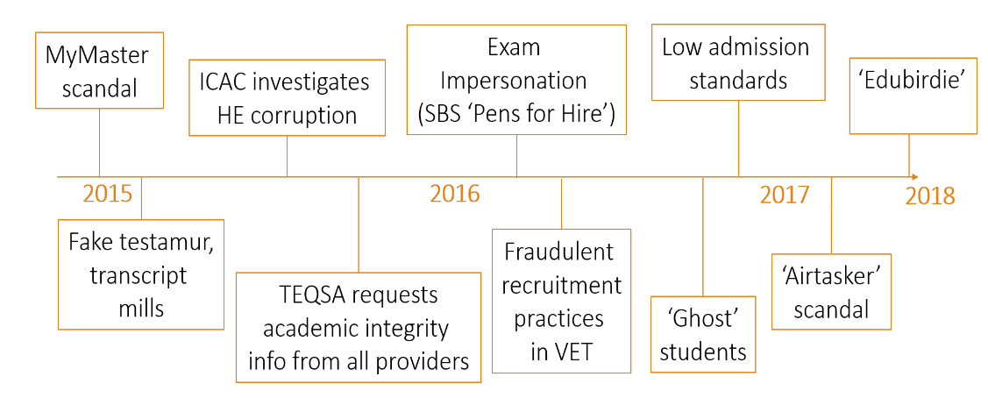
The Australian academic integrity context

Slide 12
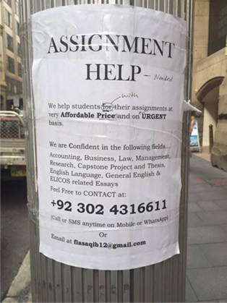
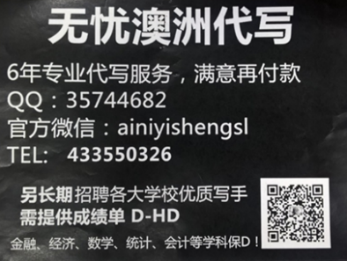

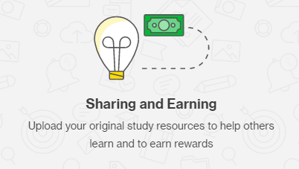
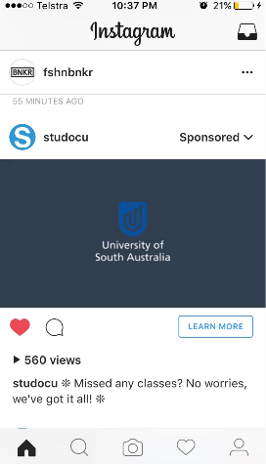

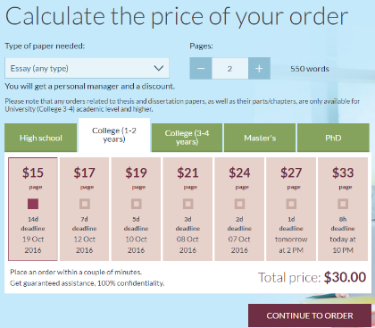
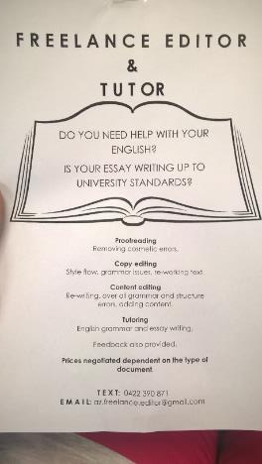


Slide 13
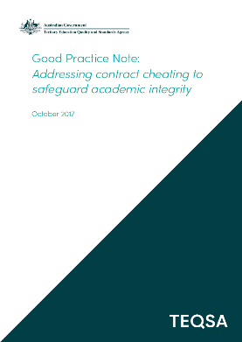
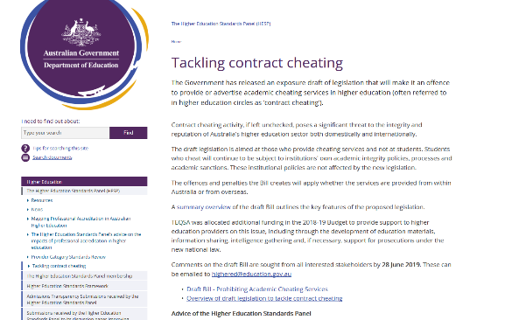
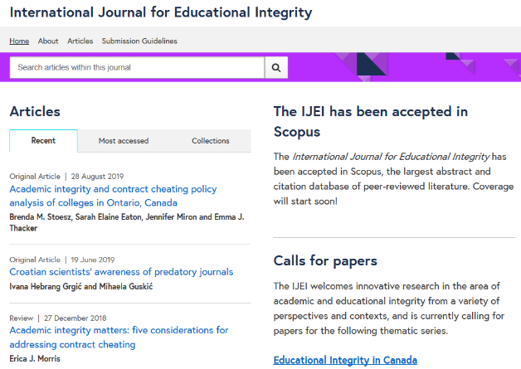
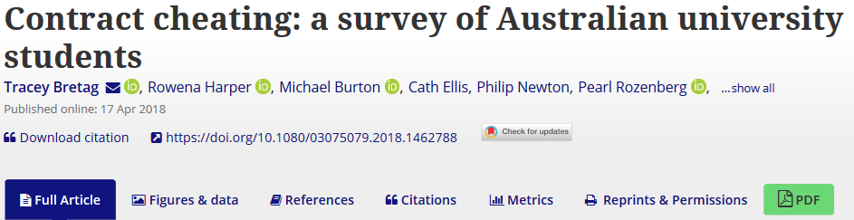
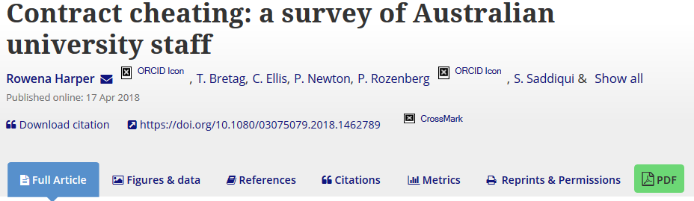
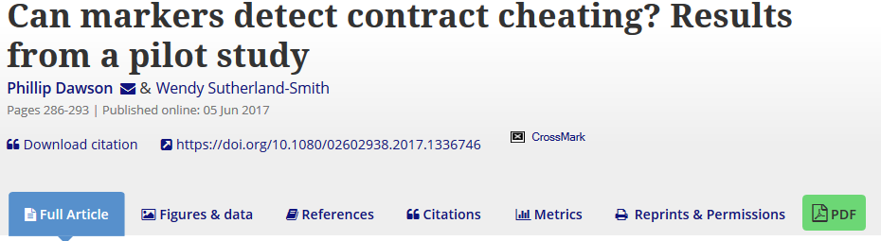
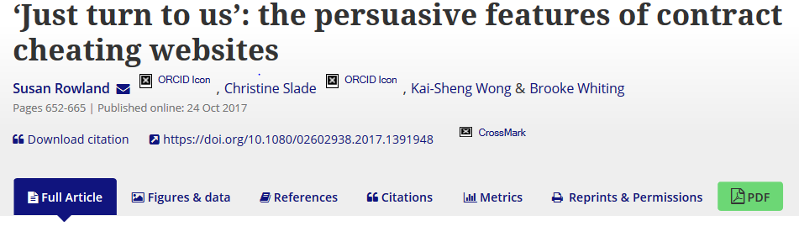
Contract cheating: Australian leadership

Slide 14
Contract cheating: A definition
“Contract cheating occurs when a student submits work that has been completed for them by a third party, irrespective of the third party’s relationship with the student, and whether they are paid or unpaid.”
(Harper & Bretag et al 2019)
Third party:
friend or family
fellow student or staff member
commercial service

Slide 15
Prevalence of Contract Cheating
* Bretag et al. (2018), + Rigby et al. (2015)

Slide 16

Who engages in contract cheating?
 | All respondents (n = 14,086) | Cheating group (n = 814) |  | All respondents (n = 14,086) | Cheating group (n = 814)
Gender |  |  | Type of institution
Female | 57.4% | 44.0% | Group of 8 (Go8) | 50.0% | 55.2%
Male | 41.1% | 54.2% | Non-Go8 | 50.0% | 44.8%
Discipline |  |  | Mode of study
Health Sciences | 20.7% | 15.6% | Internal | 64.9% | 68.6%
Business and Commerce | 17.0% | 17.2% | Blended | 25.8% | 27.1%
Engineering | 13.1% | 24.6% | External (online only) | 9.3% | 4.3%
Language spoken at home |  |  | Domicile
English | 78.8% | 59.8% | Domestic | 84.7% | 67.0%
Language other than English | 21.2% | 40.2% | International | 15.3% | 33.0%

Slide 17
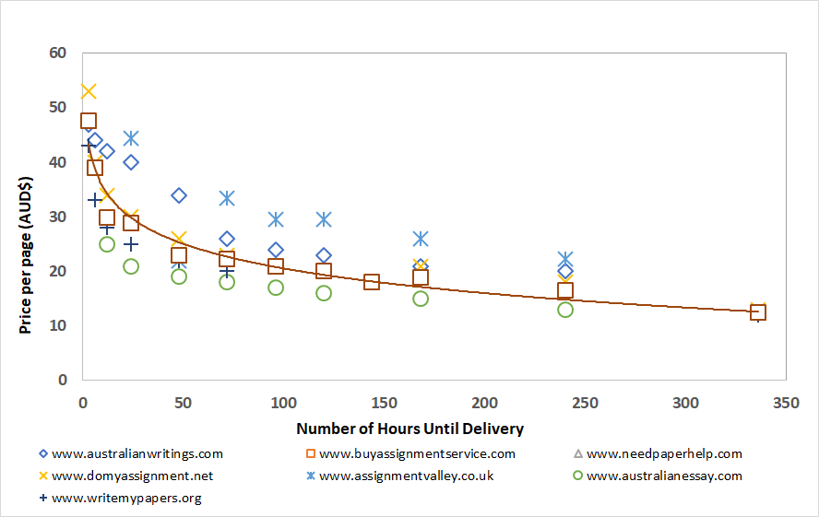
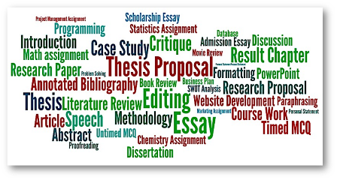
Contract cheating online services
What can students buy?
How much does it cost?
Rowland et al. (2018)

Slide 18
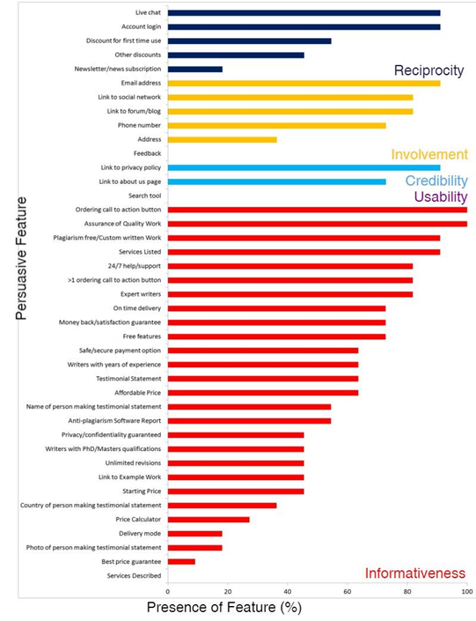
Vulnerability of students to persuasive messages of online contract cheating services
The websites use multiple persuasive features e.g.
  Live chat
  Discounts first time use
  Link to privacy policy
  Link to 'About Us' page
  Ordering button
  Assurance of quality work
  Plagiarism free - Turnitin report
  24/7 help
  Money back guarantee
  Testimonials
  Affordability – price calculator
  Delivery mode
Rowland et al. (2018)

Slide 19
Why students plagiarise and cheat
Controllable factors strongly associated with plagiarism and cheating:
Lack of understanding (Curtis & Vardanega 2016)
Perceived seriousness (Curtis & Popal 2011)
Perceived norms (Curtis et al. 2018; McCabe & Trevino 1993)
Lack of language proficiency (Bretag et al. 2018)
Poor time management and procrastination (Siaputra 2013; Wallace & Newton 2014)
Opportunities (Baird & Clare 2017; Bretag et al. 2018)
Lack of institutional support for academic integrity (Husain et al. 2017)
Student perception of staff apathy, knowledge and dedication (Husain et al. 2017)
No fear of detection and consequences (Deikhoff et al. 1999)
Student dissatisfaction with L&T environment (Bretag et al 2018; Park 2003)
Pressures and life complexity (Brimble 2016)

Slide 20
Why students plagiarise and cheat…
Psychological states and traits associated with plagiarism and cheating:
low conscientiousness (Siaputra 2013)
anxiety (Tindall & Curtis in press)
low self-control (Curtis et al. 2018)
competitive mindset (Barbaranelli et al. 2018)
impulsivity (Moss et al. 2018)
low confidence (Moss et al. 2018)
poor resilience (Moss et al. 2018)

Slide 21
Why students choose not to cheat
Reasons for not cheating
  Learning Goals
  Morality and Norms
  Institutional factors: e.g., respect for teachers, ability to get extensions
  Fear of detection and consequences
  Autonomy: self-efficacy and lack of trust in ability of provider
  Lack of opportunity
  (Rundle et al. 2019)

Slide 22
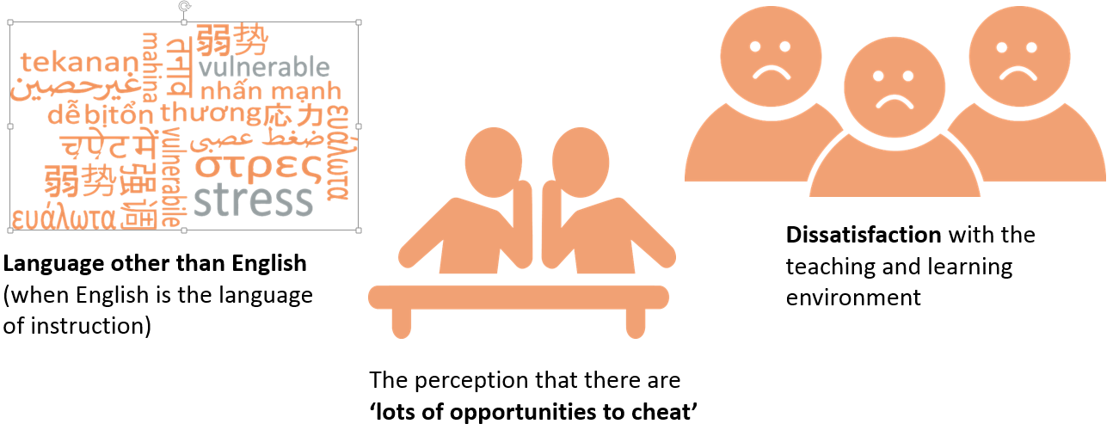
Three factors influence contract cheating
(Bretag et al 2018)

Slide 23
Contract cheating
Discussion
How do these findings about contract cheating resonate with your experience?
How has your institution responded to the issue?

Slide 24
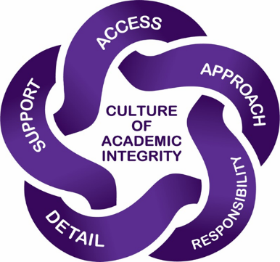
Policies and procedures to promote and uphold academic integrity
Access: Easy to locate, read, concise, comprehensible.
Approach: Statement of purpose with educative focus up-front and all through policy.
Responsibility: Details responsibilities for ALL stakeholders (not just students).
Detail: Extensive but not excessive description of breaches, outcomes and processes.
Support: Proactive and embedded systems to enable implementation of the policy (Bretag et al 2011)

Slide 25
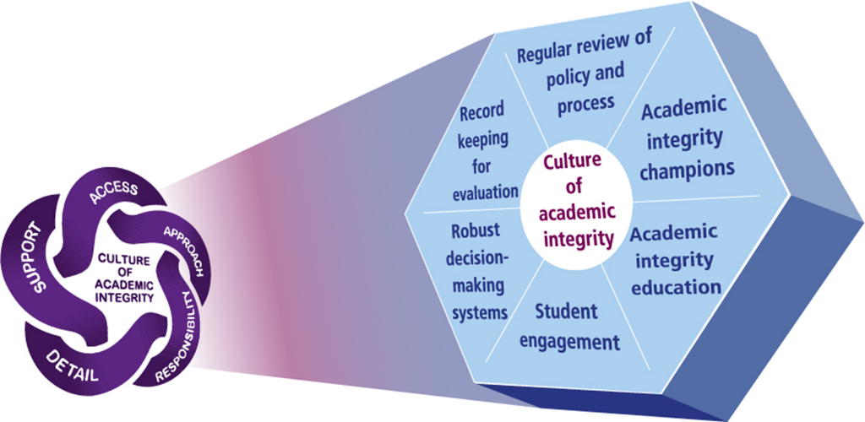
Implementing academic integrity policy
www.unisa.edu.au/EAIP

Slide 26
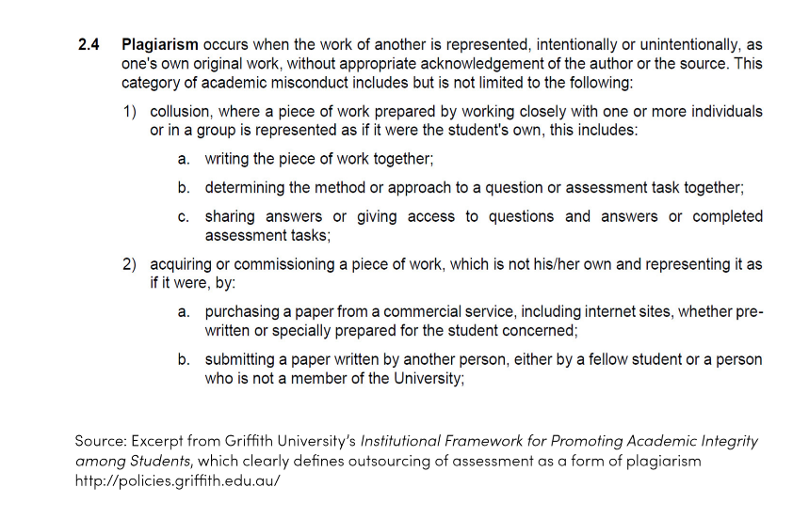
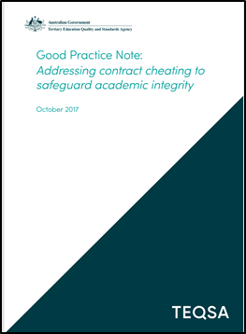
Examples of good policy

Slide 27
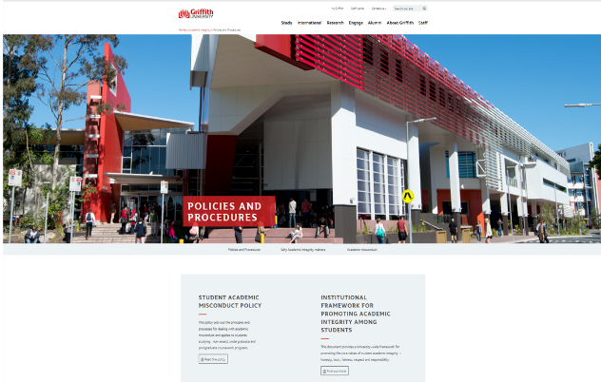
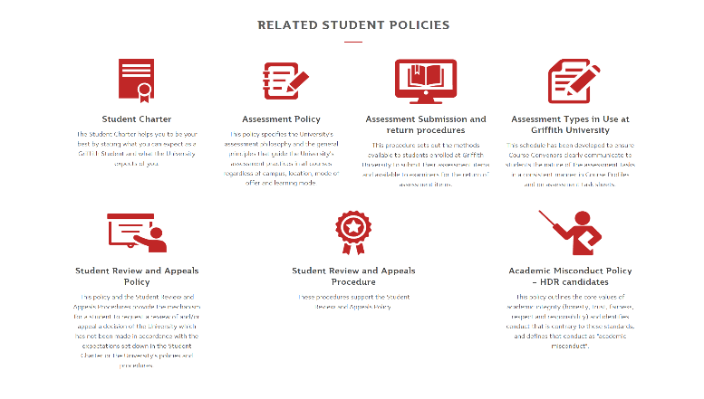
Griffith University Academic Integrity webpage https://www.griffith.edu.au/academic-integrity/policies-and-procedures

Slide 28
Identifying and responding to breaches
Use technology to aid in identification
Educate staff to understand instances of academic integrity breaches
Adequately resource staff to identify academic integrity breaches and follow policy
Senior managers need to lead by example
Challenges
  Technology may be available but under-utilised
  Staff may lack awareness (or time!)
  Staff may have concerns in implementing policy, including difficult and opaque processes, and a perceived lack of support from the institution.

Slide 29
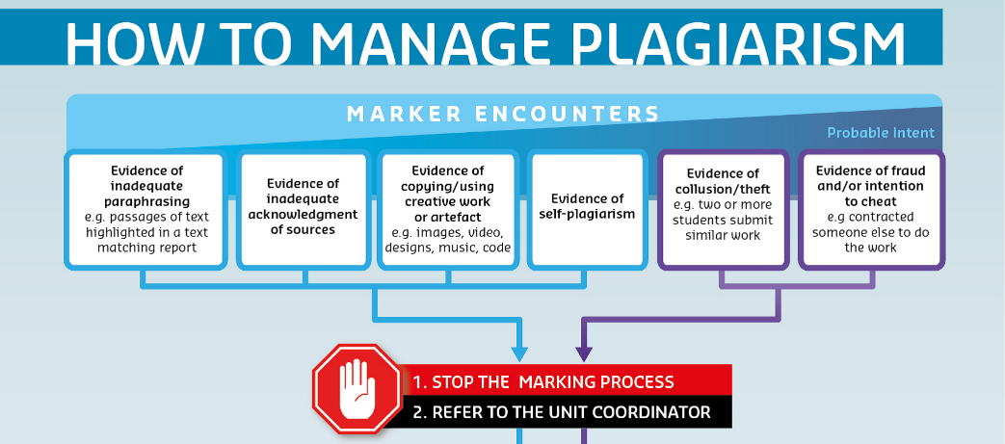
Identifying and responding to breaches - example

Slide 30
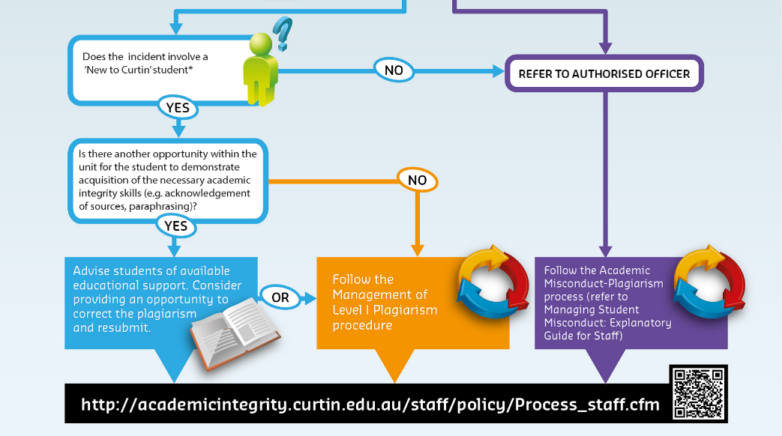

Slide 31

Policies and procedures to promote academic integrity
Discussion
Assess your institution’s academic integrity policy and process against best practice

Slide 32
Actions to mitigate risks to academic integrity
Provide consistent messages about academic integrity at all points of students’ entry to higher education:
Examples
ELICOS and language centres
‘Pathway’ providers (students in this group are particularly vulnerable to the seductive advertising of commercial cheat sites)
Other Independent Higher Education Providers
Ensure that students who have articulated into your institution have received the necessary academic integrity training (eg those who receive ‘block credit’).

Slide 33
Actions to mitigate risks to academic integrity…
Include a range of preventative measures that take into account the student life-cycle from (pre)admission through to graduation:
Provide training for all staff
  Teachers (including sessional markers)
  Senior managers
  Academic integrity breach decision-makers
  Support staff (eg librarians, learning advisors, academic developers)
  Examination invigilators
  Professional staff (eg admissions, marketing, counsellors, international advisors)
  Facilities Management (they are often the first to see cheating advertisements)

Slide 34

The teaching and learning environment
More important than curriculum design is the Personalised Teaching and Learning relationship:
Provide opportunities for students to approach lecturers and tutors for assistance
Lecturers and tutors need to ensure that students understand what is required in assignments
Ensure students receive sufficient feedback to learn from the work they do.
https://cheatingandassessment.edu.au/

Slide 35

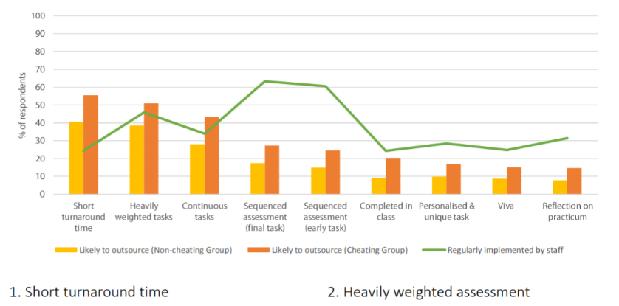
Managing risk for different assessment types
While Authentic assessment cannot prevent cheating, it may make it less likely, and may also assist in detection.
Short turnaround time
Strategy Provide early, low-stakes practice and feedback on similar/practice tasks. Allow peer collaboration if appropriate. Follow up the submission with a viva, to check that outsourcing has not occurred
Heavily weighted assessments
Strategy Provide ample prior practice and feedback opportunities. Break the task up into sequential components, submitted over time for feedback and monitoring of progress. Minimise the impact of failure on progression (e.g. supplementary assessment).

Slide 36
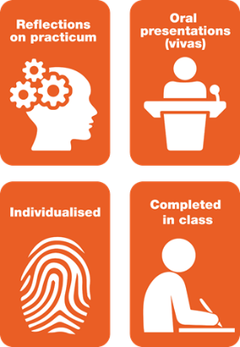
Discussion
What curriculum and assessment strategies are utilised at your institution?

Slide 37
Training and guidance for staff and students
International scholarship recommends that institutions have a central office or standing committee with a specific remit for academic integrity (HEA 2011).
Benefits:
‘The buck stops here’
Consistent approach and training across the institution
Central point of expertise for decision-making
Consistent outcomes for breaches (natural justice for students)
Resourced to provide a pro-active rather than reactive approach (eg marketing and communication)
Oversight of breach database, with reporting of issues to senior managers

Slide 38

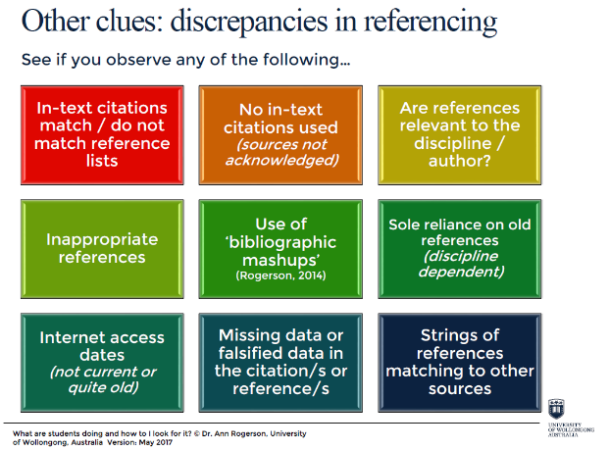
Training and guidance for staff and students - example
https://www.teqsa.gov.au/latest-news/publications/good-practice-note-addressing-contract-cheating-safeguard-academic

Slide 39
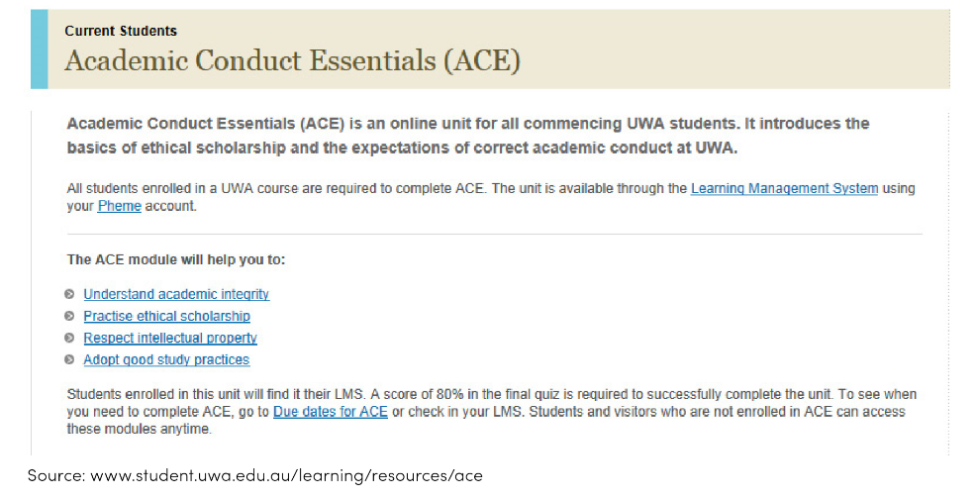
Training and guidance for staff and students example

Slide 40
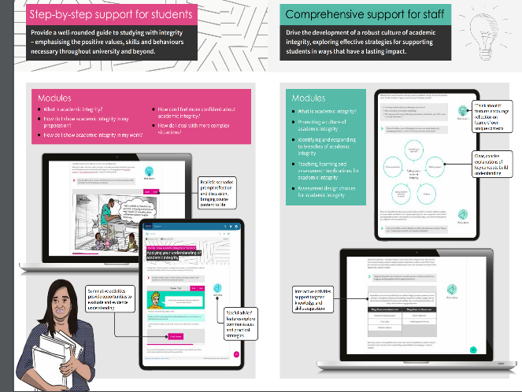
Training and guidance for staff and students - example
https://www.epigeum.com/custom/uploads/2019/03/Academic_Integrity_Flyer_Web.pdf

Slide 41

Consequences for breaches
There must be a clear and consistent framework across all disciplines, and this must be communicated to both staff and students.
Level of consequence should vary depending on:
  student education/understanding
  extent of breach
  level of student
  whether the incident is a first or repeated behaviour (this is impossible to determine if a central breach database is not maintained)
Note: All outcomes should be considered ‘educative’
Even when a suspension is applied, it is not to ‘punish’ the student but to allow the student to reflect on the behaviour and seek the necessary support for successful learning.

Slide 42
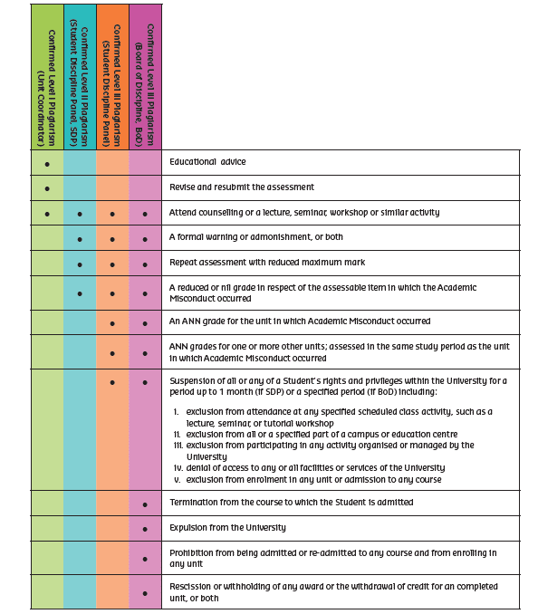
Clear guidelines to ensure consistent outcomes - example

Slide 43
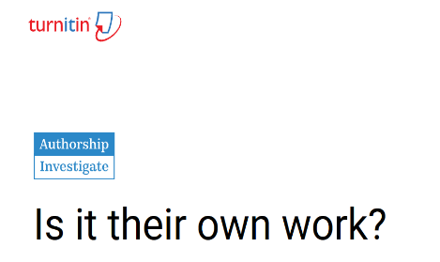

Contract cheating often goes unreported
Three reasons:
Perceptions that it’s ‘impossible to
prove’
2. Too time consuming
3. Staff don’t feel encouraged to report
Technology can help – but it must be adequately resourced, and both staff and students need training
https://www.turnitin.com/products/authorship-investigate

Slide 44


Substantiating contract cheating
Key principles
Educate staff
Investigate a range of ‘signals’ of cheating
Follow your institution’s policy and procedure
Not ‘proof’ but ‘balance of probabilities’ – clear and convincing evidence
Examine: Look at all aspects of document; interview student
Collect evidence from a range of sources
Trust your own experience
Ensure natural justice and make sure student is supported
Evaluate all the evidence to form an overall picture
Textual signals
1. Text matching – low or high
2. Document properties
3. Not appropriate for discipline area
4. Academic quality different to expectations
5. Language mismatch
6. Inappropriate or false references
7. Doesn’t meet the assignment criteria
8. Foreign language references
9. The assignment just seems strange in relation to other students’ submissions – trust your instinct and consult with a trained decision-maker

Slide 45
Substantiating contract cheating
Discussion
What other strategies could you use to substantiate contract cheating?
Share with the whole group

Slide 46
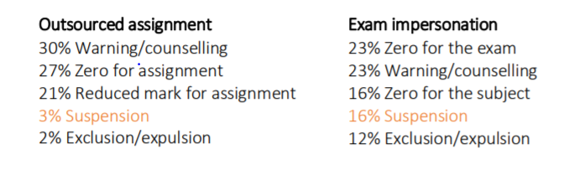

Consequences for contract cheating
Staff reported lenient treatment of contract cheating and exam impersonation:
Consequences should be severe for substantiated cases of contract cheating (Harper et al. 2018). The Good Practice Note recommends a minimum of zero for the assessment, failure in the course/unit, and six months’ suspension from the institution.

Slide 47
Building a culture of academic integrity
Make academic integrity visible to all

Slide 48
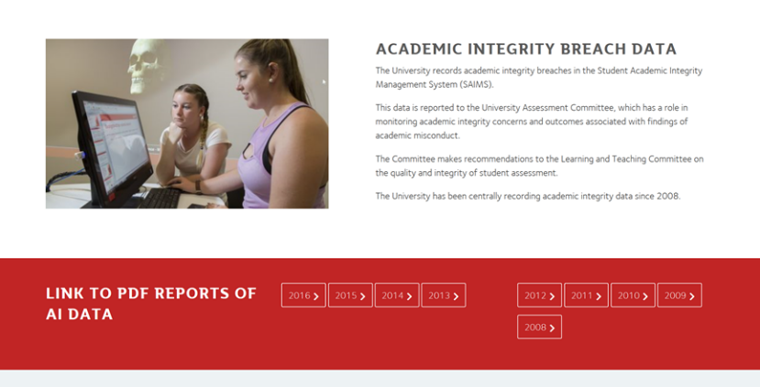
Make academic integrity visible
https://www.griffith.edu.au/academic-integrity/academic-misconduct

Slide 49
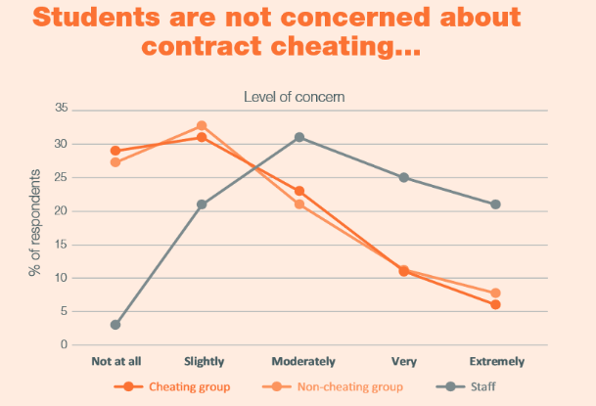
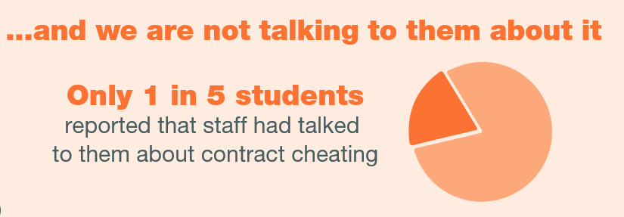
Talk to students

Slide 50

Partner with students
Student engagement: We need to encourage students to be partners, rather than passive recipients in academic integrity education.
Include student representatives in governance committees, including academic integrity breach decision-making
http: www.unisa.edu.au/EAIP

Slide 51
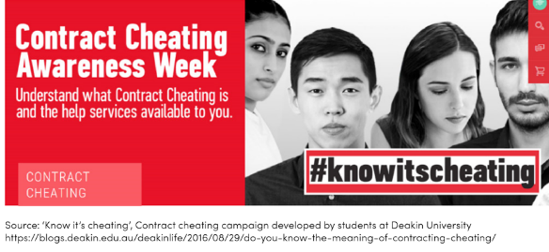
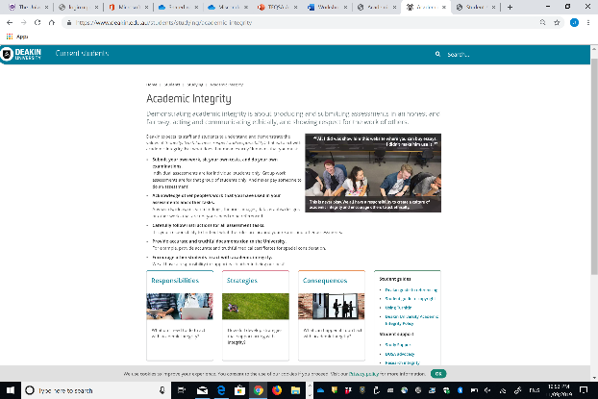
Partner with students
https://www.deakin.edu.au/students/studying/academic-integrity

Slide 52
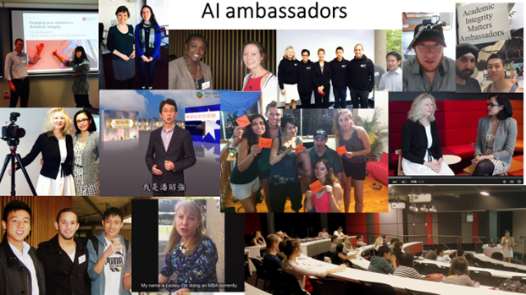
Students as academic integrity champions
The Academic Integrity Matters Ambassadors (AIMA) is a student-led organisation founded at Macquarie University in 2014.
AIMA provides meaningful engagement, consultation and collaboration, and enlists students to serve as change agents in their own right.
Image source: Students as Partners in Academic Integrity,
presentation by Sonia Saddiqui at 7APCEI 2015.

Slide 53
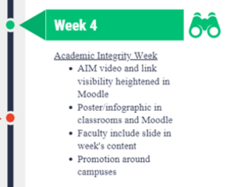
More examples of partnering with students
Videos made by students to promote the importance of Ghostwriting and Contract Cheating - https://youtu.be/HRhekZ9uq0o
UTS Academic Integrity Board Game – co-designed with UTS Business School students as part of a Learner Engagement Grant https://aibg.amandalovestoaudit.com/
Providing materials for discussions at SRC meetings or student groups on International Day of Action on Contract Cheating http://contractcheating.weebly.com/ or a local Academic Integrity Week
ICMS Academic Integrity Week

Slide 54
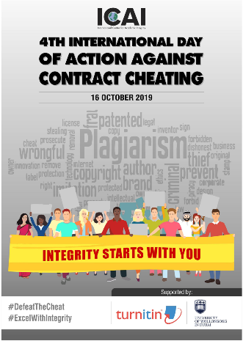
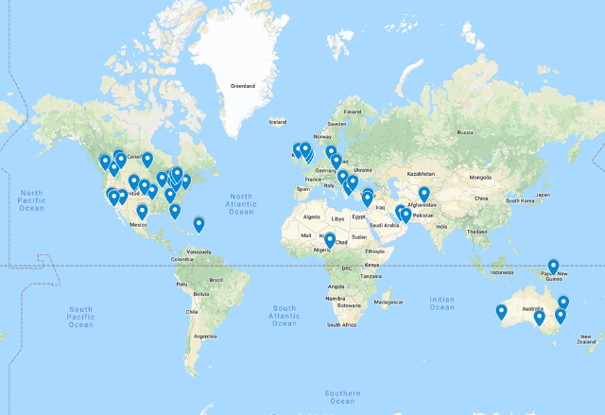
International Day of Action Against Contract Cheating

Slide 55
Discussion
What happens at your institution?
How do you partner with students to build a culture of academic integrity?

Slide 56
Transformational change (Spies & McNeill, TEQSA 2017)
Curriculum context
Teachers & teaching
Induction
Organisational structure
Reward & recognition
Student experience & outcomes
Assessment
Program & unit design
Incentives
Roles & expectations
software
Leadership
Culture
Pedagogies
Performance management
L&T innovation
infrastructure
feedback
Alignment of approaches
Technology
Organisation & strategy
resources
Learning management systems
support
Governance
classroom technologies
Record keeping & reporting
Capability development
policies
On-campus hardware
learning resources
Learning design
recruitment
Classroom management strategies
Content
Technology support for students and teachers
Roles & expectations
Project management and change management

Slide 57
Sustainable change
Adapting the Transformation Model into the context of academic integrity illustrates that implementing sustainable change in any institution requires an holistic approach to aligning these components:
Organisation and strategy
An institutional strategy which promotes academic integrity
Training
An ‘everybody’s business approach to academic integrity
Curriculum
Tasks designed to reduce the risk of breaches
Technology
Online resources and guides available JIT
Clear, aligned and regularly reviewed policies and procedures
Monitoring and reporting
Training and support about the ‘why’ and the ‘how’
Academic integrity embedded into staff roles, induction, performance appraisals and culture.
Personalised learning and teaching relationships built into culture
Authentic tasks linked to future needs, to motivate and engage
Software for text matching
Whole-of-institution record keeping and reporting

Slide 58
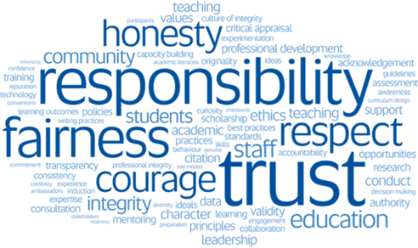
Discussion
Who has a remit for academic integrity across your institution?
What needs to happen to ensure sustainable change at your institution?

Slide 59

Post-workshop survey
Please complete the post-workshop survey (on the other side of the page) and hand to the workshop facilitator.
Thank you for your feedback!

Slide 60
Acknowledgements
We wish to acknowledge the generous funding provided by the Australian Government for the following projects:
  Academic Integrity Standards Project
  Exemplary Academic Integrity Project
  Contract Cheating and Assessment Design Project.
We also thank the Asia Pacific Forum on Educational Integrity, and all of our colleagues who have assisted in data collection, analysis and reporting of findings over many research projects and publications.
Finally, we acknowledge the support of our own institutions:
  The University of South Australia
  The University of Queensland
  The University of Western Australia
  International College of Management, Sydney

Slide 61
References
Stock images from: https://www.pexels.com
Baird, M. and Clare, J., (2017). Removing the opportunity for contract cheating in business capstones: a crime prevention case study. International Journal for Educational Integrity 13(1), p.6.
Barbaranelli, C., Farnese, M.L., Tramontano, C., Fida, R., Ghezzi, V., Paciello, M. and Long, P., (2018). Machiavellian ways to academic cheating: A mediational and interactional model. Frontiers in Psychology 9 (695) doi: 10.3389/fpsyg.2018.00695.
Bretag, T., Harper, R., Burton, M., Ellis, C., Newton, P., Rozenberg, P., Saddiqui, S. and van Haeringen, K., (2018). Contract cheating: A survey of Australian university students. Studies in Higher Education, pp.1-20.
Bretag, T., Harper, R., Rundle, K., Newton, P.M., Ellis, C., Saddiqui, S. and van Haeringen, K., (2019). Contract cheating in Australian higher education: a comparison of non-university higher education providers and universities. Assessment & Evaluation in Higher Education, pp.1-15.
Bretag, T., Mahmud, S., Wallace, M., Walker, R., James, C., Green, M., East, J., McGowan, U. and Partridge, L. (2011). Core elements of exemplary academic integrity policy in Australian higher education, International Journal for Educational Integrity 7(2): 3-12.
Brimble, M., (2016). Why Students Cheat: An Exploration of the Motivators of Student Academic Dishonesty in Higher Education. Chapter 26 in T. Bretag (Ed.), Handbook of Academic Integrity (Singapore: Springer), pp. 365–382.
Curtis, G.J. & Clare, J. (2017). How prevalent is contract cheating and to what extent are students repeat offenders? Journal of Academic Ethics 15, pp. 115-124. DOI: 10.1007/s10805-017-9278-x

Slide 62
References
Curtis, G.J., Cowcher, E., Greene, B.R., Rundle, K., Paull, M. and Davis, M.C., (2018). Self-Control, injunctive norms, and descriptive norms predict engagement in plagiarism in a theory of planned behavior model. Journal of Academic Ethics 16(3), pp.225-239.
Curtis, G.J. and Popal, R., (2011). An examination of factors related to plagiarism and a five-year follow-up of plagiarism at an Australian university. International Journal for Educational Integrity, 7(1), pp.30-42.
Curtis, G.J. and Vardanega, L., (2016). Is plagiarism changing over time? A 10-year time-lag study with three points of measurement. Higher Education Research & Development 35(6), pp.1167-1179.
Diekhoff, G. M., LaBeff, E. E., Shinohara, K., & Yasukawa, H. (1999). College Cheating in Japan and the United States. Research in Higher Education 40(3), pp. 343–353.
Ellery, K. (2008). An Investigation into Electronic-Source Plagiarism in a First-Year Essay Assignment. Assessment & Evaluation in Higher Education 33(6), pp. 607–617.
Foltynek, T., Kravjar, J., & Glendinning, I. (2014). Case study: Policies, Strategies and Responses to Plagiarism in Slovakia. Journal on Efficiency and Responsibility in Education and Science 7(1), pp. 19–25.
Franklyn-Stokes, A., & Newstead, S. E. (1995). Undergraduate Cheating: Who Does What and Why? Studies in Higher Education 20(2), pp. 159–172. DOI: 10.1080/03075079512331381673
Gilmore, J., Strickland, D., Timmerman, B., Maher, M., & Feldon, D. (2010). ‘Weeds in the Flower Garden’: An Exploration of Plagiarism in Graduate Students Research Proposals and its Connection to Enculturation, ESL, and Contextual Factors. International Journal for Educational Integrity 6, pp. 13–28.

Slide 63
References
Harper, R., Bretag, T., Ellis, C., Newton, P., Rozenberg, P., Saddiqui, S. and van Haeringen, K., (2018). Contract cheating: a survey of Australian university staff. Studies in Higher Education, pp.1-17.
Higher Education Academy (HEA). (2011a). Policy works: Recommendations for Reviewing Policy to Manage Unacceptable Academic Practice in Higher Education. Retrieved from http://www.heacademy.ac.uk/resources/detail/academicintegrity/policy_works
Higher Education Academy (HEA). (2011b). Supporting Academic Integrity: Approaches and Resources for Higher Education. Retrieved from https://www.heacademy.ac.uk/system/files/supportingacademicintegrity_v2_0.pdf
Husain, F.M., Al-Shaibani, G.K.S. and Mahfoodh, O.H.A., (2017). Perceptions of and attitudes toward plagiarism and factors contributing to plagiarism: A review of studies. Journal of Academic Ethics 15(2), pp.167-195.
Kremmer, M. L., Brimble, M. A., & Stevenson-Clarke, P. (2007). Investigating the Probability of Student Cheating: The Relevance of Student Characteristics, Assessment Items, Perceptions of Prevalence and History of Engagement. International Journal for Educational Integrity 3(2), pp. 3–17.
McCabe, D. L. (1992). The Influence of Situational Ethics on Cheating Among College Students. Sociological Inquiry 62, pp. 365–374.
McCabe, D. L. & Trevino, L. K. (1993). Academic Dishonesty: Honor Codes and Other Contextual Influences. Journal of Higher Education 64, pp. 522–538.
McCabe, D.L. & Trevino L. K. (1995). Cheating among Business Students: A Challenge for Business Leaders and Educators. Journal of Management Education 19(2), pp. 205–218.

Slide 64
References
McCabe, D.L. & Trevino L. K. (1995). Cheating among Business Students: A Challenge for Business Leaders and Educators. Journal of Management Education 19(2), pp. 205–218.
McCullough, M., and Holmberg, M. (2005). Using the Google Search Engine to Detect Word-For-Word Plagiarism in Master’s Theses: A Preliminary Study. College Student Journal 39, pp. 435–441.
Marsden H., Carroll M., & Neill J. T. (2005). Who cheats at university? A Self-Report Study of Dishonest Academic Behaviours in a Sample of Australian University Students Australian Journal of Psychology 57, pp. 1-10.
Moss, S.A., White, B. and Lee, J., (2018). A systematic review into the psychological causes and correlates of plagiarism. Ethics & Behavior 28(4), pp.261-283.
Park, C. (2003). In Other (People’s) Words: Plagiarism by University Students - Literature and Lessons. Assessment & Evaluation in Higher Education 28(5), pp. 471–488. DOI: 10.1080/0260293032000120352.
Rigby, D., Burton, M., Balcombe, K., Bateman, I., and Mulatu, A. (2015). Contract Cheating and the Market in Essays. Journal of Economic Behaviour and Organization 111, pp. 23–37.
Rowland, S., Slade, C., Wong, K.S. & Whiting, B. (2018). ‘Just turn to us’: the persuasive features of contract cheating websites, Assessment & Evaluation in
Higher Education, 43:4, 652-665, doi: 10.1080/02602938.2017.1391948
Rundle, K., Curtis G. J., & Clare, J. (2019). Why students don’t engage in contract cheating. Frontiers in Psychology. doi: 10.3389/fpsyg.2019.02229

Slide 65
References
Siaputra, I.B., (2013). The 4PA of plagiarism: A psycho-academic profile of plagiarists. International Journal for Educational Integrity 9(2).
Scanlon, P. M., & Neuman, D.R. (2002). Internet Plagiarism Among College Students. Journal of College Student Development 43(3), pp. 374-385.
Segal, S., Gelfand, B. J., Hurwitz, S., Berkowitz, L., Ashley, S. W., Nadel, E. S. & Katz, J. T. (2010). Plagiarism in Residency Application Essays. Annals of Internal Medicine 153(2), pp. 112–121.
Smyth, M., & Davis, J. (2004). Perceptions of Dishonesty Among Two-Year College Students: Academic Versus Business Situations. Journal of Business Ethics 51, pp. 63-73.
Spies, M. & McNeill, M. (2017) Holistic Curriculum Transformation: A Scalable Model for Student Success. Proceedings of Tertiary Education Quality and Standards (TEQSA) Conference, Melbourne, Australia. Retrieved from:
https://www.hes.edu.au/resources/2017-teqsa-conference-proceedings
Tindall, I. K., & Curtis, G. J. (in press). Negative emotionality is related to more positive attitudes toward plagiarism. Journal of Academic Ethics. doi: 10.1007/s10805-019-09343-3
Universities Australia (2017). Academic Integrity Best Practice Principles, https://www.universitiesaustralia.edu.au/wp-content/uploads/2019/06/UA-Academic-Integrity-Best-Practice-Principles.pdf
Wallace, M.J. and Newton, P.M., (2014). Turnaround time and market capacity in contract cheating. Educational Studies 40(2), pp.233-236.

Slide 66
Links to academic integrity organisations
Asia Pacific Forum on Educational Integrity
www.apfei.edu.au
European Network on Academic Integrity
www.academicintegrity.eu
Higher Education Academy
www.heacademy.ac.uk
Impact of plagiarism policies in Higher Education Across Europe
http://plagiarism.cz/ippheae/
International Center for Academic Integrity
www.academicintegrity.org
Plagiarismadvice.org
www.plagiarismadvice.org

Slide 67
Links to Australian academic integrity research projects
Academic Integrity in Australia – Understanding and Changing Culture and Practice (2015), led by Macquarie University. This project supports students’ active participation in academic integrity and appreciation of different cultural approaches to plagiarism, including guidelines and resources for establishing academic integrity student societies. http://web.science.mq.edu.au/academic-integrity/index.html
Academic integrity standards: Aligning policy and practice in Australian universities (2013), led by the University of South Australia. This project identified five core elements of exemplary academic integrity policy: Access, Approach, Responsibility, Detail and Support, and provides resources to support good practice. www.aisp.apfei.edu.au
Contract cheating and assessment design: Exploring the connection (2016-2019), led by the University of South Australia. This project investigated the role of assessment to minimise contract cheating, using surveys of students and staff at 12 higher education providers, plus longitudinal academic integrity breach data from one university and a large dataset of procurement notices on commercial cheat sites. www.cheatingandassessment.edu.au
Embedding and extending exemplary academic integrity policy and support frameworks across the higher education sector (2014), led by the University of South Australia. This project provides an Academic Integrity Policy Toolkit and resources, accessible to both public and private higher education institutions, to embed exemplary policy, with a focus on support systems for international English as Additional Language (EAL) students, educationally less prepared students and postgraduate research students. www.unisa.edu.au/EAIP
Investigating the efficacy of culturally specific academic literacy and academic honesty resources for Chinese Students (2010), led by Victoria University. This project provides a range of multimedia resources for Chinese students to support understanding, transition, acculturation and engagement regarding general academic conduct in an Australian university environment. http://www.olt.gov.au/resource-efficacy-culturally-specific-academic-literacy-vu-2010
Plagiarism and related issues in assessment not involving text (2015), led by The University of Newcastle. This project increased understanding of and attitudes to student academic integrity in areas of study that involve non-text-based assessment. It provided exemplars of good practice in helping students and strategies useful for academics. https://core.ac.uk/download/pdf/51344093.pdf
Web 2.0 authoring tools in higher education: new directions for assessment and academic integrity (2011), led by The University of Melbourne. This project provides resources for academics who wish to plan or review the assessment of their students’ web 2.0 activities, including blogs, social networking media, wiki writing and audio/video podcasting. http://www.olt.gov.au/resource-web-20-authoring-tools-higher-education-new-directions-assessment-and-academic-integrity-20
Working from the Centre: Supporting unit and course coordinators to implement academic integrity policies, resources and scholarship (2014), led by Victoria University. This project provides online resources for unit/course coordinators, whose duties sit at the intersection between the development and implementation of institutional approaches to academic integrity. https://sites.google.com/site/academicintegrityresources/home

